Slide 1


An initiative of the University System of Georgia and GALILEO, Georgia’s Virtual Library

Slide 2



Projects to Support College Affordability
Affordable Learning Georgia provides faculty with the support they need to implement Open Educational Resources (OER), library resources, and other affordable resources in place of a commercial textbook through Textbook Transformation Grants. Faculty also create revisions of existing OER and new ancillary materials through ALG Mini-Grants.
A One-Stop Center for Affordable Resources
Affordable Learning Georgia’s website provides a place for training, search tools, a weekly newsletter, research, reports, and requests for proposals for new rounds of Textbook Transformation Grants: www.affordablelearninggeorgia.org.
A Community of Practice
Affordable Learning Georgia Campus Champions and Library Coordinators help raise awareness of Open Educational Resources to faculty, and help interested faculty in finding, evaluating, revising, remixing, and even creating new OER.

Slide 3
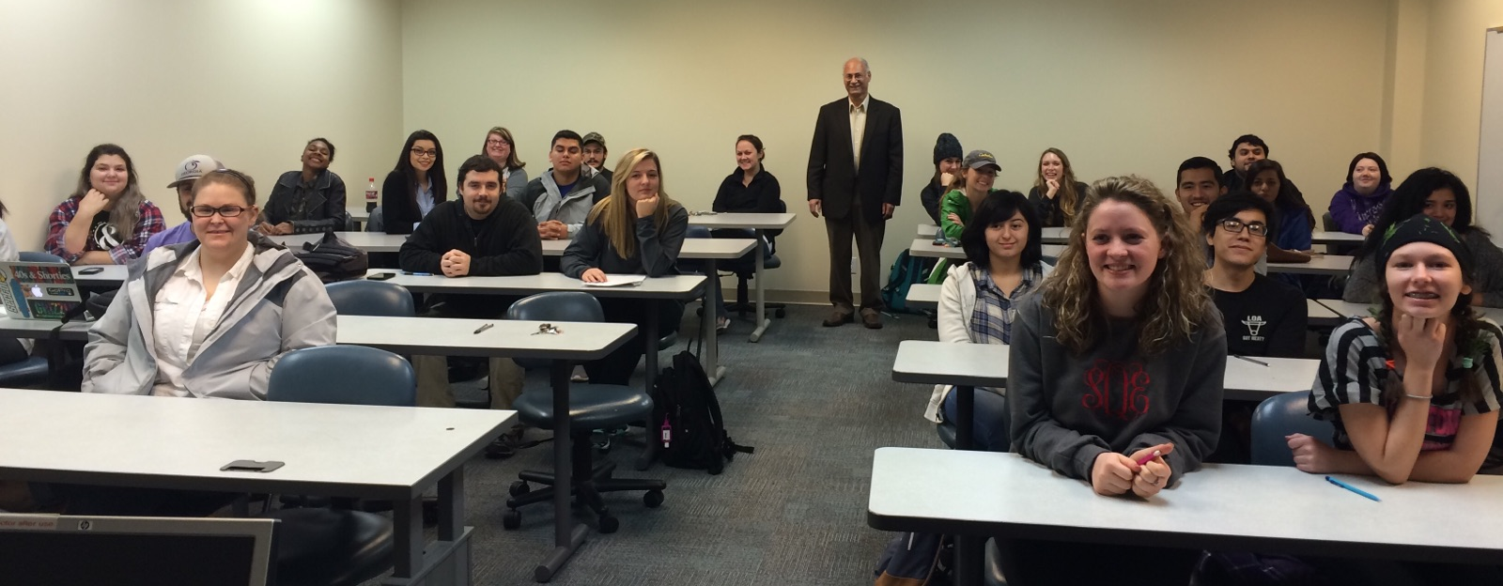
Team: Hassan El-Najjar, Natalie Johnson
Institution: Dalton State College
Course(s): SOCI 1101
Cost Savings Per Student: $183.00
Report Link: http://oer.galileo.usg.edu/psychology-collections/2/
“The transformation impact on instruction was very positive, in that it allowed the instructors the opportunity to develop supplemental materials accompanying the textbook (chapter outlines, study guides, and power-point presentations), which facilitated and benefited the teaching and learning experience.”

Slide 4
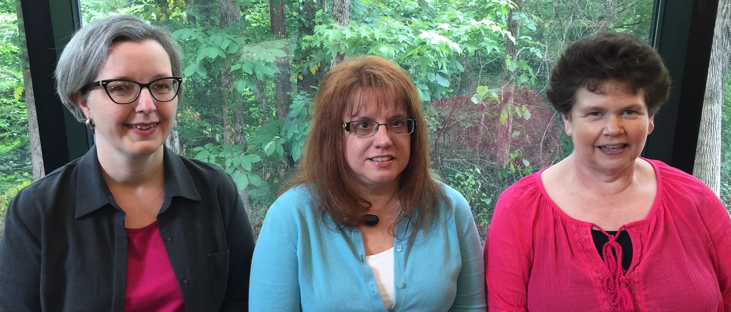
Team: Jenny Crisp, Lydia Postell, Melissa Whitesell
Institution: Dalton State College
Course(s): ENGL 0098, 0989, 0999
Cost Savings Per Student: $68.00
Report Link: http://oer.galileo.usg.edu/english-collections/2/
“This improvement in DFW rates in the first semester of implementation is truly remarkable and is a reversal of a multi-year trend in English 0098: students enrolled in the spring term are almost always repeating the course, and results in spring and have traditionally been much worse than results in the fall semester.”

Slide 5
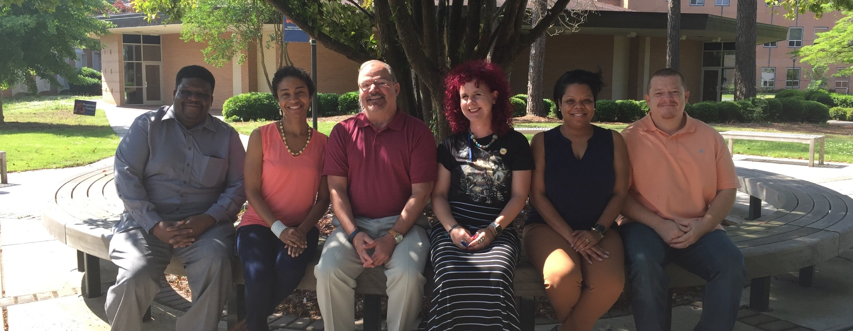
Team: Antoinette Miller, Samuel Maddox, Mark Dadonna, Christina Grange, Eckart Werther, Nichelle Gause
Institution: Clayton State University
Course(s): PSYC 1101
Cost Savings Per Student: $137.00
Report Link: http://oer.galileo.usg.edu/psychology-collections/5/
“As a general rule, our experience with this course transformation has made us more aware of the potential for OER in our courses, and encouraged us to explore additional avenues for our other courses. As college costs continue to rise and with the substantial proportion of our students requiring financial assistance, we see this as another means to support our student learning.”

Slide 6
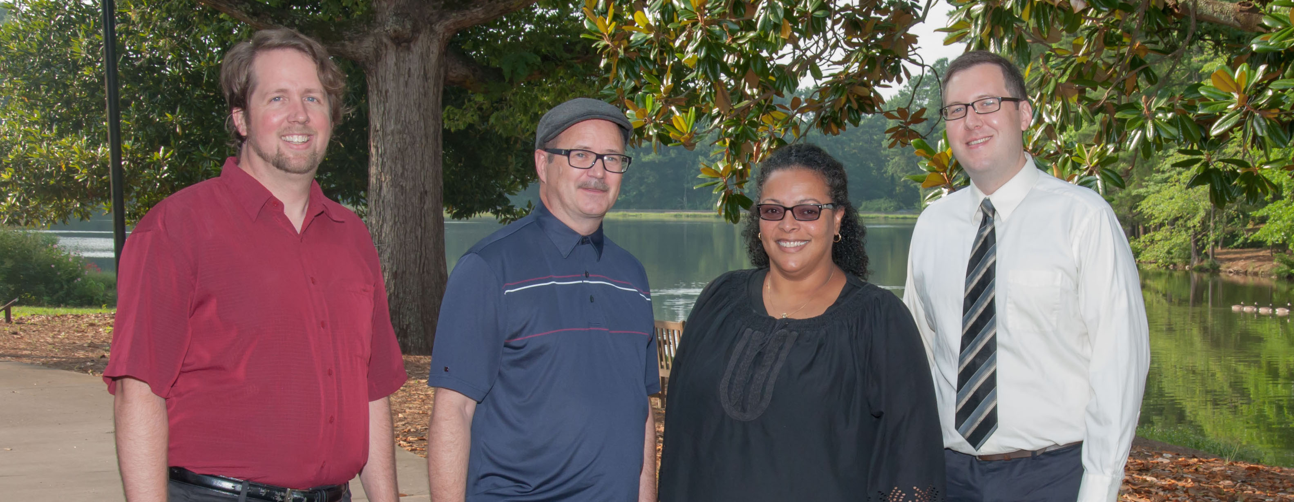
Team: Brian Amsden, Mark May, Susan McFarlane-Alvarez, Jonathan Harris
Institution: Clayton State University
Course(s): COMM 1110
Cost Savings Per Student: $80.00
Report Link: http://oer.galileo.usg.edu/communication-collections/1/
“These materials were customized and may better reflect the student body at Clayton State, which is quite diverse, whereas the [commercial textbook's] videos showed traditional first-year students at a largely white research oriented university.”

Slide 7
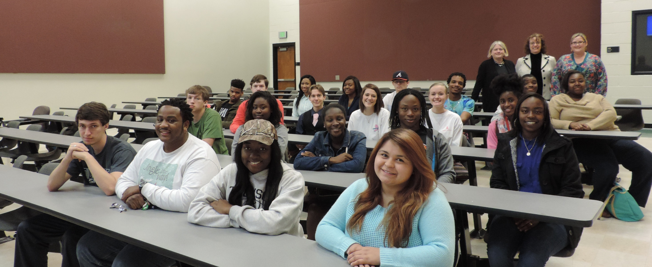
Team: Deborah Liss-Green, Elizabeth Perkins, Caryl Nemajovsky, Shalonda Heard
Institution: Albany State University (Darton)
Course(s): THEA 1100
Cost Savings Per Student: $178.00
Report Link: http://oer.galileo.usg.edu/arts-collections/1/
“We are also excited that we were able to realign our assessments with our student learning outcomes and that we were able to obtain extensive student feedback regarding the materials used for the course. Our ability to track student learning and attitudes has proven most valuable as we reassess the course and what is needed to provide the very best learning experience for our students.”

Slide 8
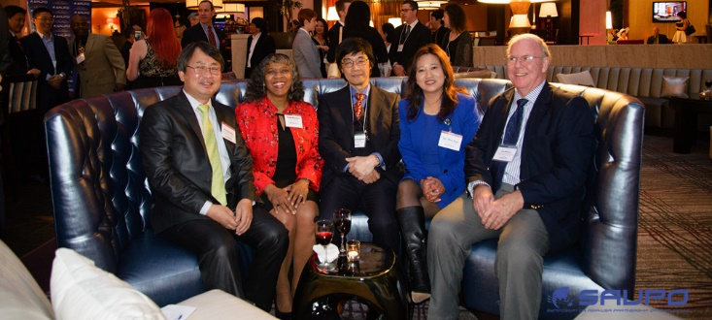
Team: Ginny Zhan, May Gao, Yumin Ao
Institution: Kennesaw State University
Course(s): ASIA 1102
Cost Savings Per Student: $176.00
Report Link: http://oer.galileo.usg.edu/history-collections/1/
“This grant is very much appreciated to help us strengthen the BA curriculum, and attract students to the new major.”

Slide 9
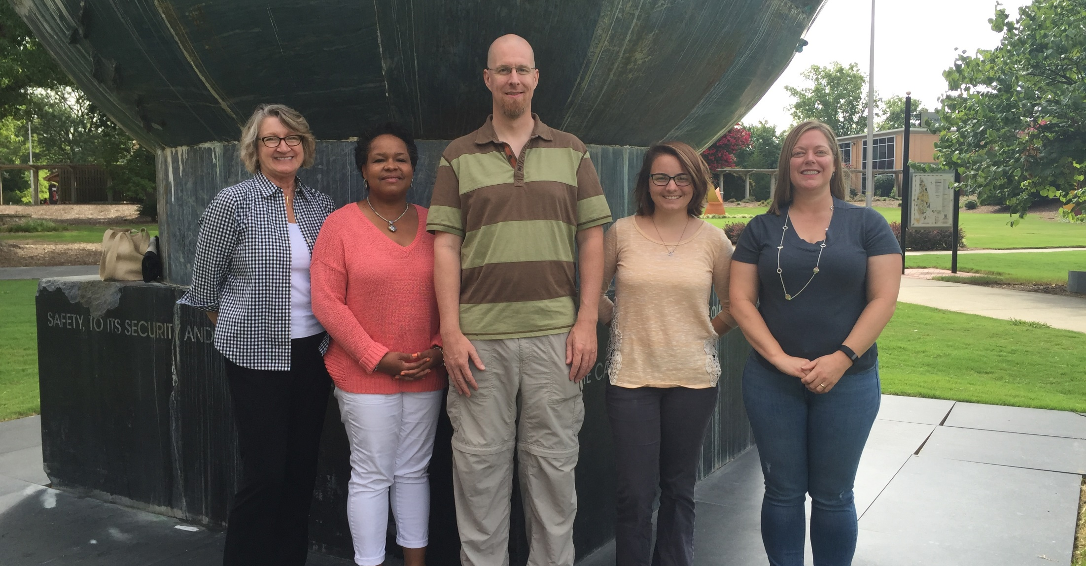
Team: Tamara Powell, Jonathan Arnett, Monique Logan, Cassandra Race, Tiffani Reardon, Lance Linimon, James Monroe
Institution: Kennesaw State University
Course(s): TCOM 2020, WRIT 3140
Cost Savings Per Student: $116.00
Report Link: http://oer.galileo.usg.edu/communication-collections/4/
“The transformation experience was exhilarating and inspiring as we achieved our dream of creating a resource for students that was under our control and reflected the way we wanted to teach.”

Slide 10
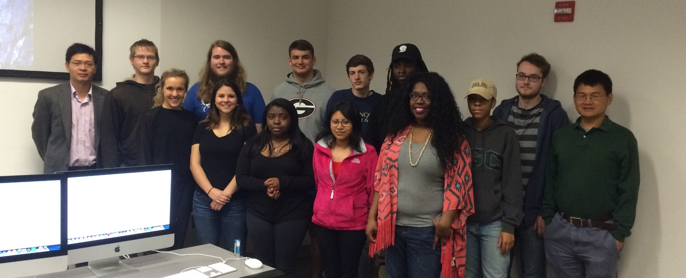
Team: Shuhua Lai, Kairui Chen
Institution: Georgia Gwinnett College
Course(s): ITEC 2110
Cost Savings Per Student: $270.00
Report Link: http://oer.galileo.usg.edu/compsci-collections/6/
“The instruction experience for faculty who piloted the implementation of the no-cost-to-student course learning material was improved by having more relevant and up to date course material freely available to students on the first day of class, which eliminated the situation that some students could not afford a textbook.”

Slide 11
An initiative of the University System of Georgia and GALILEO, Georgia’s Virtual Library

Slide 12
Projects to Support College Affordability
Affordable Learning Georgia provides faculty with the support they need to implement Open Educational Resources (OER), library resources, and other affordable resources in place of a commercial textbook through Textbook Transformation Grants. Faculty also create revisions of existing OER and new ancillary materials through ALG Mini-Grants.
A One-Stop Center for Affordable Resources
Affordable Learning Georgia’s website provides a place for training, search tools, a weekly newsletter, research, reports, and requests for proposals for new rounds of Textbook Transformation Grants: www.affordablelearninggeorgia.org.
A Community of Practice
Affordable Learning Georgia Campus Champions and Library Coordinators help raise awareness of Open Educational Resources to faculty, and help interested faculty in finding, evaluating, revising, remixing, and even creating new OER.

Slide 13
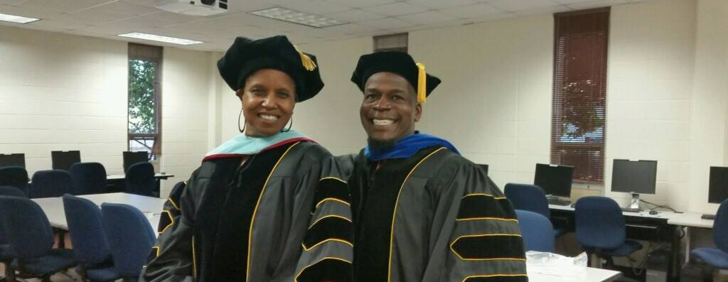
Team: Carlton Usher, Linda Lyons
Institution: Kennesaw State University
Course(s): KSU 1111
Cost Savings Per Student: $270.00
Report Link: http://oer.galileo.usg.edu/fye-collections/1
“Open resources contributed to high-level engagement and learning according to both Professor and student.”

Slide 14
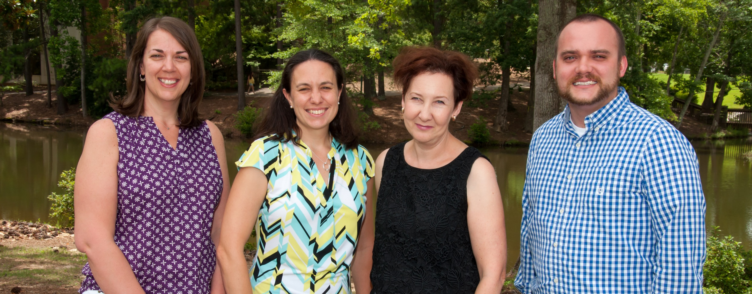
Team: Tatiana Krivosheev, Bram Boroson, Caroline Sheppard, Patricia Todebush, Justin Mays
Institution: Clayton State University
Course(s): PHYS 2211, 2212, 1111, 1112;
CHEM 1211, 1212, 2411, 2412
Cost Savings Per Student: $28.00
Report Link: http://oer.galileo.usg.edu/chemistry-collections/7
"It made all the information available in one place: theory and the report. Everything is done for you as long as you put in the right code. Less papers to print, meaning less money to spend on papers and ink." -Student

Slide 15
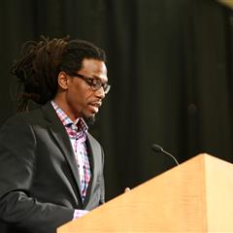
Team: J. Sean Callahan, Amy Burger
Institution: Georgia Highlands College
Course(s): PSYC 1101
Cost Savings Per Student: $218.00
Report Link: http://oer.galileo.usg.edu/psychology-collections/7/
"I really enjoyed using the OpenStax Psych book. Often times buying an expensive book that you rarely use can be a burden, but using this book as much as I did and receiving it for free is a relief." -Student

Slide 16
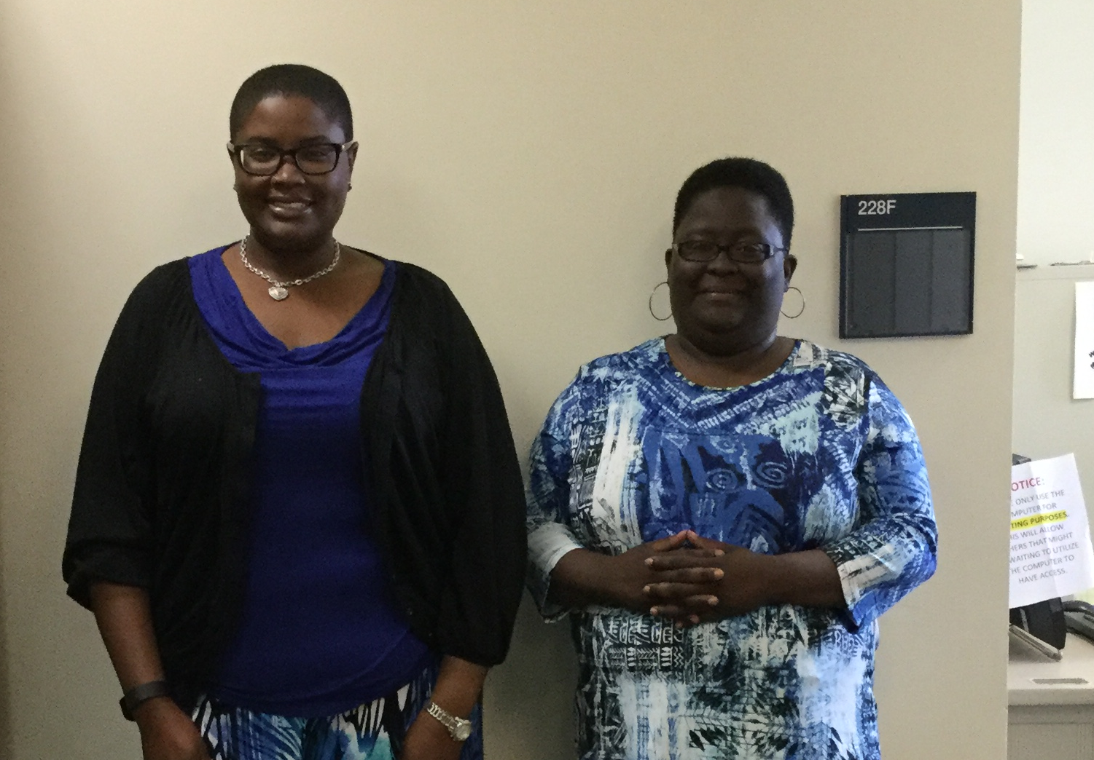
Team: Shayla Williams, Kenya Lemon
Institution: Albany State University
Course(s): BIOL 1111
Cost Savings Per Student: $130.00
Report Link: http://oer.galileo.usg.edu/biology-collections/1/
"I would be able to print out certain pages and go through them thoroughly with a highlighter and pen. It is a lot less hassle." -Student

Slide 17
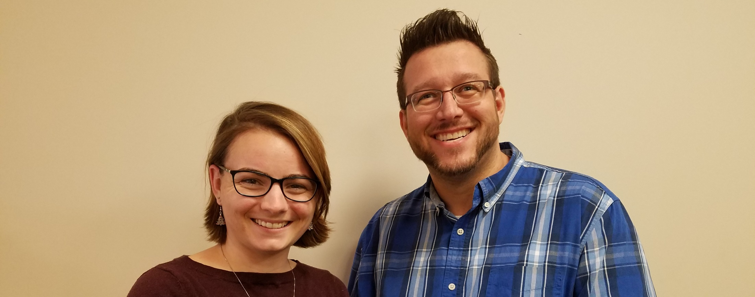
Team: Daniel Farr, Tiffani Reardon
Institution: Kennesaw State University
Course(s): SOCI 1101
Cost Savings Per Student: $233.00
Report Link: http://oer.galileo.usg.edu/psychology-collections/12/
"My professor did a good job wrapping his course around this textbook. The price was perfect - and there were several ways to approach the material: either on the go, in textbook form, and even in both full-book or single-chapter PDF form." -Student

Slide 18
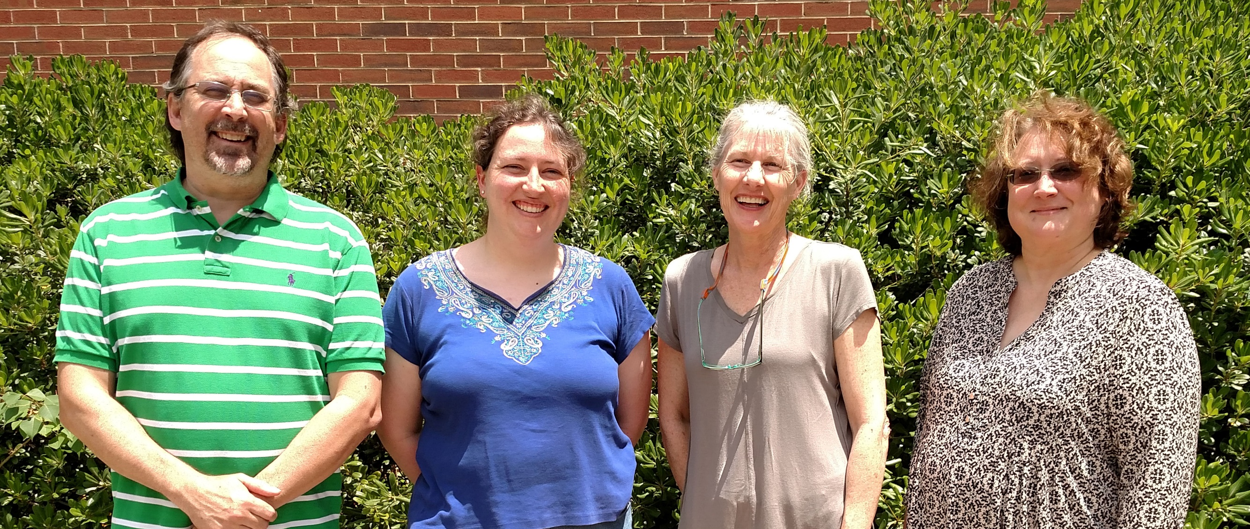
Team: Stephanie Harvey, Tom Lorenz, Ian Brown, Tommy Wright, Anh-Hue Thi Tu, Yonnie Williams
Institution: Georgia Southwestern State University
Course(s): BIOL 1107, 1108
Cost Savings Per Student: $285.00
Report Link: http://oer.galileo.usg.edu/biology-collections/11/
“Historically, some students reported not having their textbooks until midterm due to financial limitations while other did not purchase the textbook at all. This produced an unacceptable bias in the classroom. The availability of the zero cost textbook eliminates this bias and helped ensure that all students have equal access to required materials.”

Slide 19
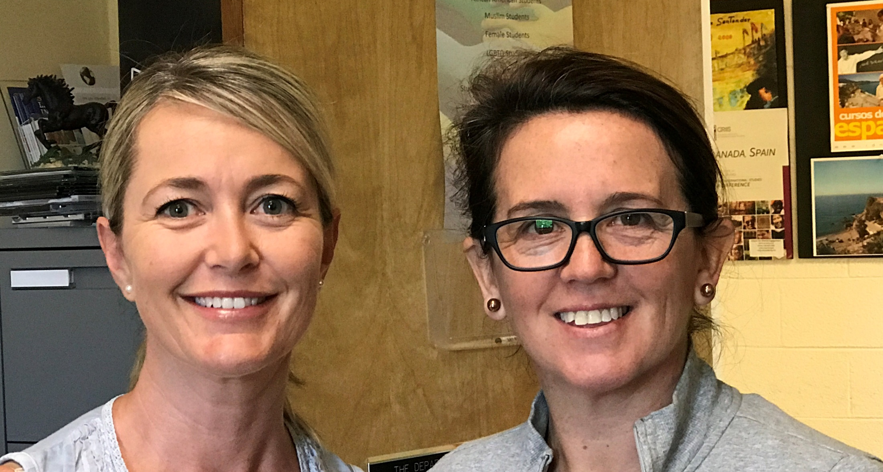
Team: Valerie Hastings, Mariana Stone
Institution: University of North Georgia
Course(s): FREN 1001, FREN 1002
Cost Savings Per Student: $278.00
Report Link: http://oer.galileo.usg.edu/languages-collections/1/
“The new no‐cost online textbooks also allowed us to update the material and include very current authentic cultural sources (such as videos or songs), which kept the students more informed and engaged. Overall, the improved and easier access to the required and recommended materials allowed the students to feel more confident and improve their class performance.”

Slide 20
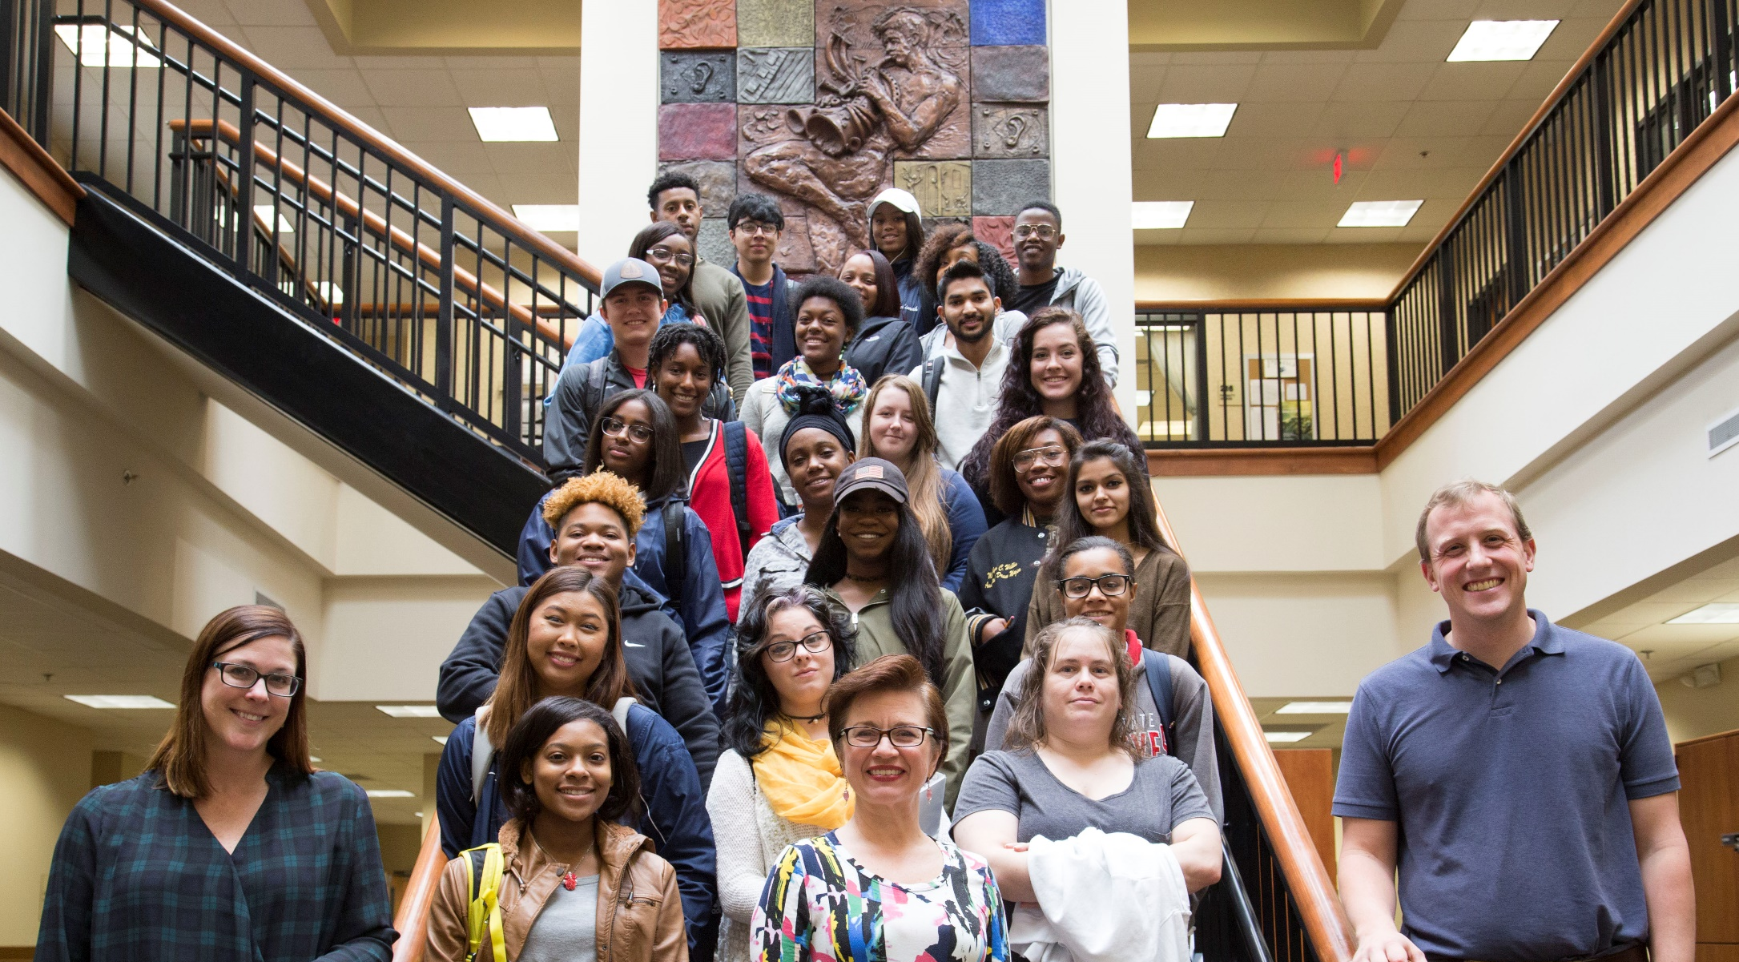
Team: Nancy Conley, Michael Fuchs, Christina Howell
Institution: Clayton State University
Course(s): MUSC 2101
Cost Savings Per Student: $149.00
Report Link: http://oer.galileo.usg.edu/arts-collections/4/
"My experience with the no-cost material was definitely one of the best things Clayton State has provided me with. Being a student athlete at Clayton State, I was able to do homework on the bus rides to away games, comfortably. Unlike my other classes, I would have had to take 3 huge books on the bus with me." -Student

Slide 21
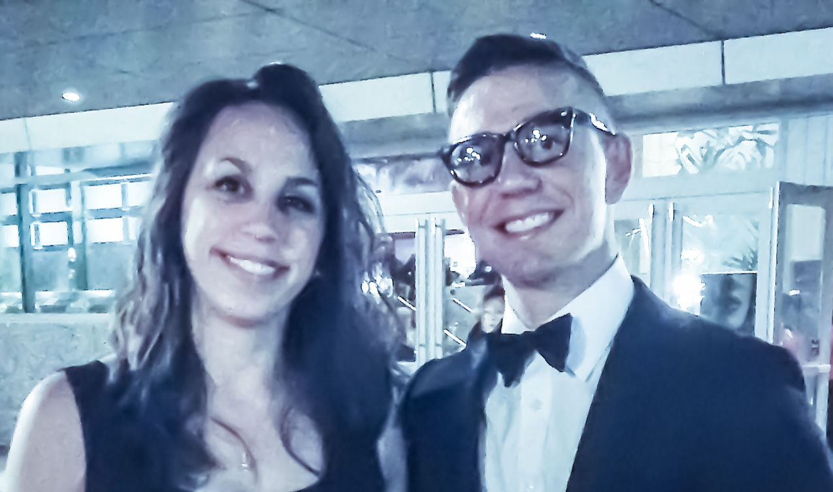
Team: Andrea Allen, Scott Jacques
Institution: Clayton State University
Course(s): SOC 4501, CRJU 4501, CRJU 3020
Cost Savings Per Student: $114.00
Report Link: http://oer.galileo.usg.edu/criminal-collections/1/
"It was convenient and affordable. I’m broke and would not have been able to afford a textbook [without OER]." -Student

Slide 22
An initiative of the University System of Georgia and GALILEO, Georgia’s Virtual Library

Slide 23
Projects to Support College Affordability
Affordable Learning Georgia provides faculty with the support they need to implement Open Educational Resources (OER), library resources, and other affordable resources in place of a commercial textbook through Textbook Transformation Grants. Faculty also create revisions of existing OER and new ancillary materials through ALG Mini-Grants.
A One-Stop Center for Affordable Resources
Affordable Learning Georgia’s website provides a place for training, search tools, a weekly newsletter, research, reports, and requests for proposals for new rounds of Textbook Transformation Grants: www.affordablelearninggeorgia.org.
A Community of Practice
Affordable Learning Georgia Campus Champions and Library Coordinators help raise awareness of Open Educational Resources to faculty, and help interested faculty in finding, evaluating, revising, remixing, and even creating new OER.

Slide 24
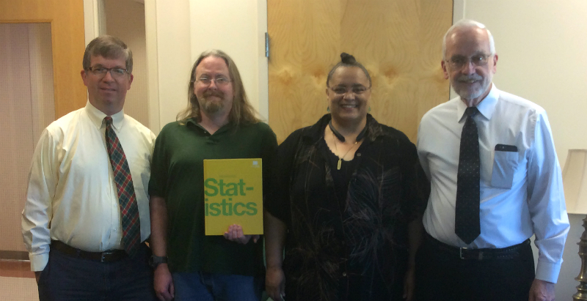
Team: Neal Smith, Daphne Skipper, Christopher Terry, Marvalisa Payne
Institution: Augusta University
Course(s): MATH 2210
Cost Savings Per Student: $252.95
Report Link: http://oer.galileo.usg.edu/mathematics-collections/22/
"I thoroughly enjoy the idea of being able to open my book up in another screen on my home computer or wherever I go on my phone or tablet. It really contributes to my ability to grasp the in-betweens of what we discussed in class. I love the convenience of having it with me wherever I go."

Slide 25
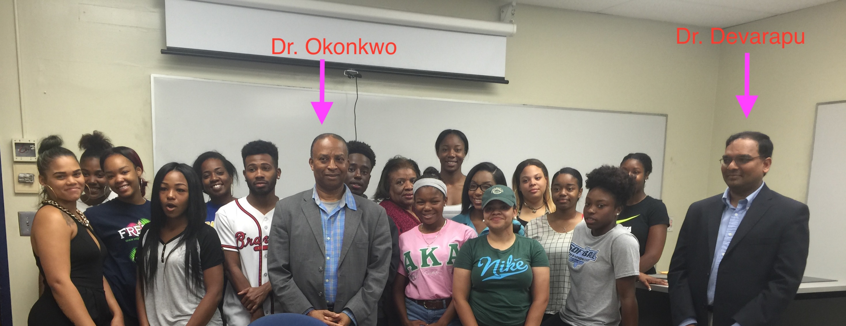
Team: Zephyrinus Okonkwo, Anilkumar Devarapu
Institution: Albany State University
Course(s): MATH 2411
Cost Savings Per Student: $379.00
Report Link: http://oer.galileo.usg.edu/mathematics-collections/15
"This course gave me easy free access to all the course materials instead of having to wait for the financial aid refunds to buy the textbook, by that time I will so far behind the class." -Student

Slide 26
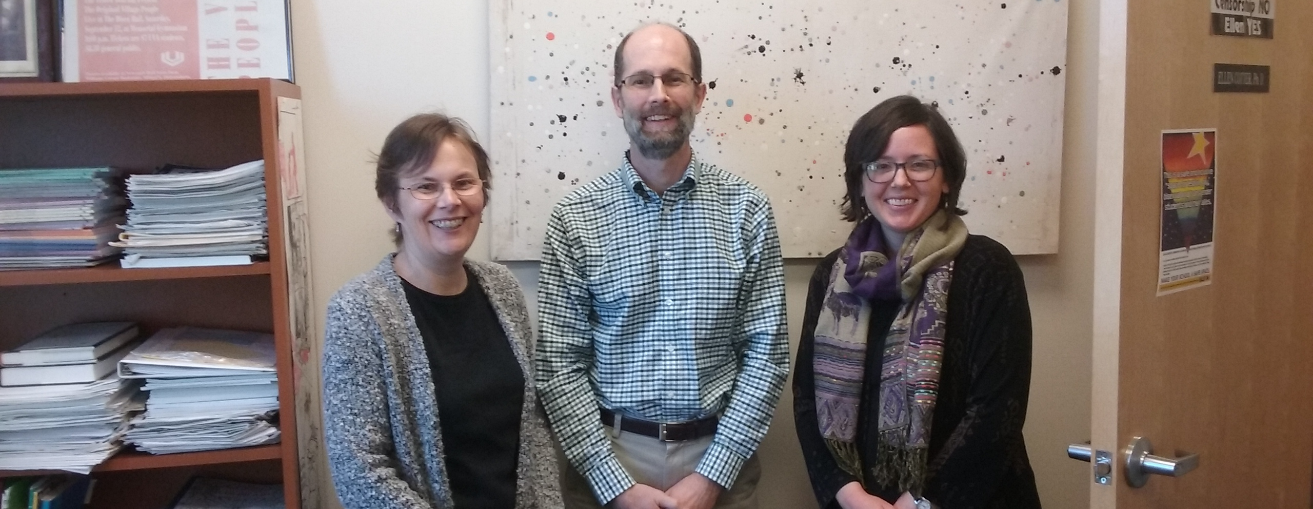
Team: Ellen Cotter, Judy Orton Grissett, Gary Fisk
Institution: Georgia Southwestern State University
Course(s): PSYC 2103
Cost Savings Per Student: $144.50
Report Link: http://oer.galileo.usg.edu/psychology-collections/6/
“The OER project inspired us to collaborate more and share resources we developed, such as PowerPoint presentations and test bank questions. We hope to continue this collaborative effort in future semesters.”

Slide 27
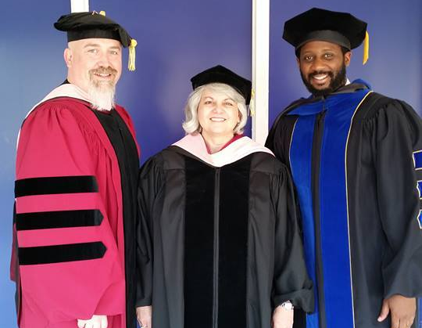
Team: Mark Laughlin, Ru Story-Huffman, Julie Megginson, Robert Bryant
Institution: Georgia Southwestern State University
Course(s): MUSC 1100
Cost Savings Per Student: $205.91
Report Link: http://oer.galileo.usg.edu/arts-collections/2/
“The feedback from students have been overwhelmingly positive to the OER. The students appreciated the no-cost option for the textbook, and the additional study guides that were created by the faculty.”

Slide 28
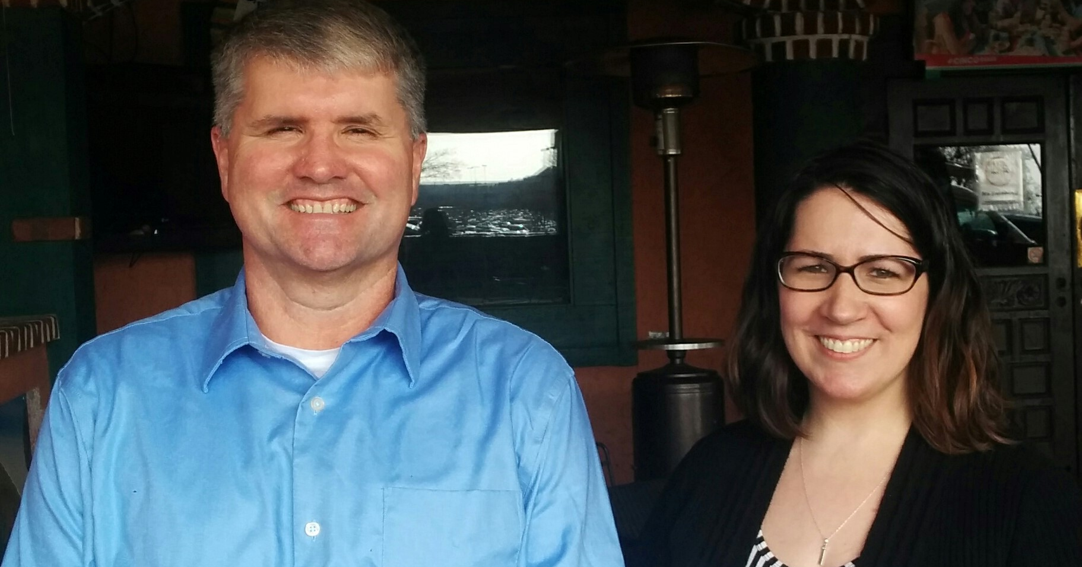
Team: Alicia Briganti, John Gulledge
Institution: Dalton State College
Course(s): PSYC 1101
Cost Savings Per Student: $153.25
Report Link: http://oer.galileo.usg.edu/psychology-collections/8/
“Because we found that students were satisfied with the materials and because performance improved in comparison to past semesters when traditional textbooks were used, we will continue to use no-cost materials so that the impact goes beyond what was proposed for this grant.”

Slide 29
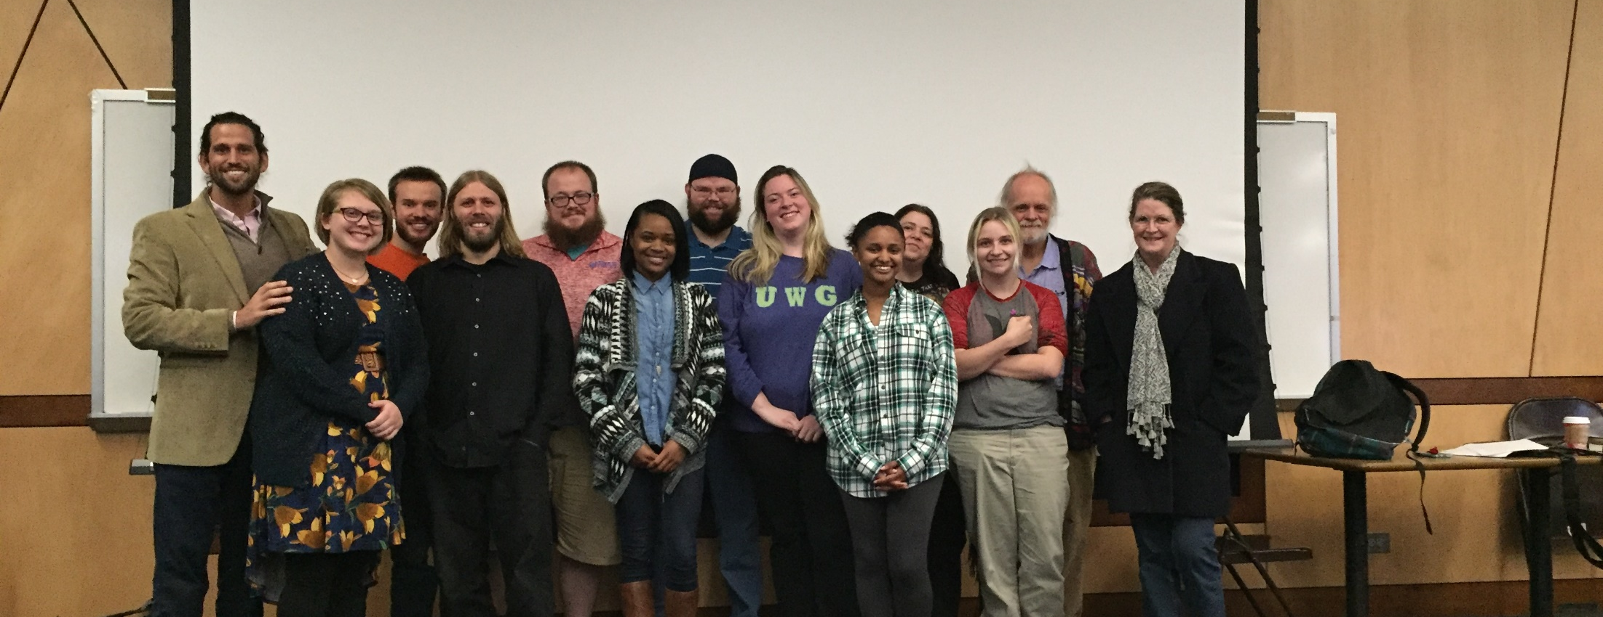
Team: Mark A. Kunkel, Fiona Gallagher, Cher Hendricks
Institution: University of West Georgia
Course(s): PSYC 1101
Cost Savings Per Student: $200.00
Report Link: http://oer.galileo.usg.edu/psychology-collections/13/
“But overall the lesson learned was that it is worth what it costs to try to level the playing field for students, and to facilitate at a minimum their access to affordable learning materials. It was certainly worth the effort.”

Slide 30
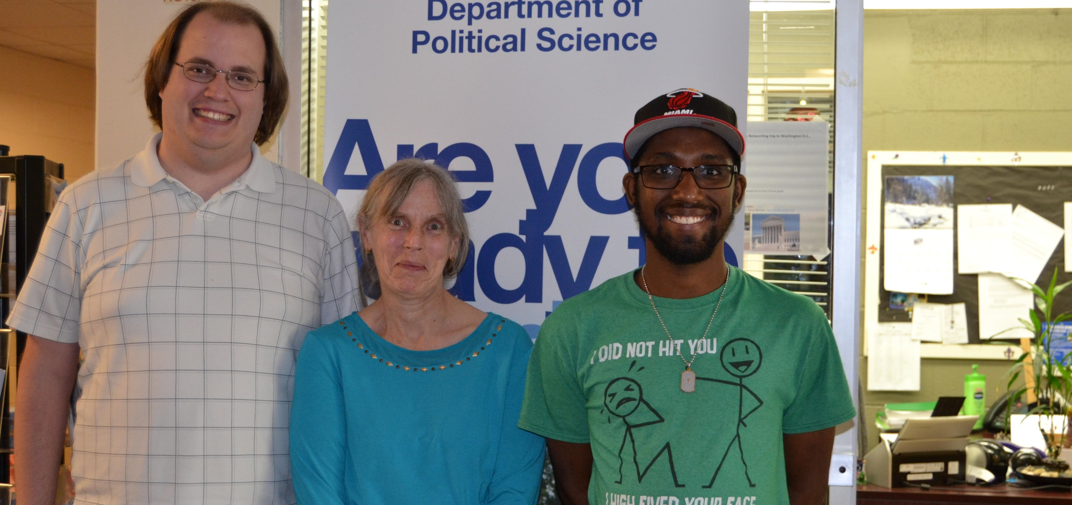
Team: Kathleen Barrett, Brian Jones
Institution: University of West Georgia
Course(s): POLS 1101
Cost Savings Per Student: $177.20
Report Link: http://oer.galileo.usg.edu/polisci-collections/1/
“The impact of this transformation on my instruction was that I no longer had to teach “to” a particular book. I used the lectures to ensure students understood the basic ideas and the supplemental material to reinforce or provide examples of that information. It also allowed me the flexibility to structure the course according to the interests of the class.”

Slide 31
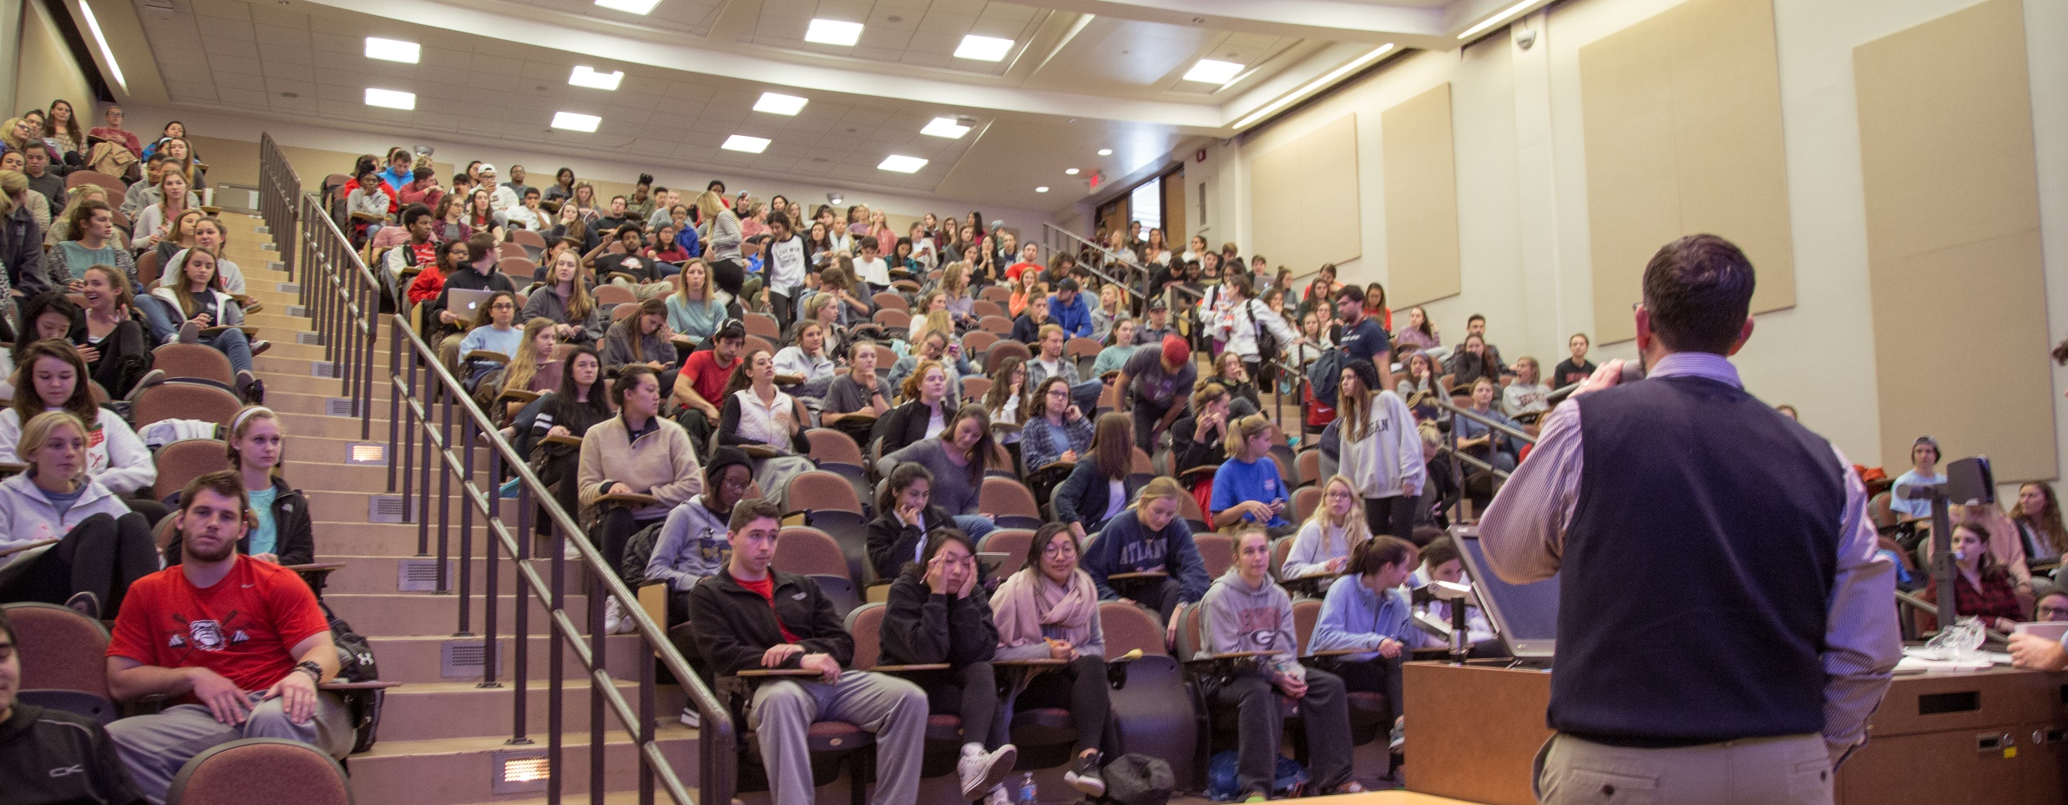
Team: Deanna Cozart, DeLoris Wenzel Hesse, Brett Szymik, Rob Nichols, Leslie Pryor, C. Edward Watson
Institution: University of Georgia
Course(s): CBIO 2200, 2210
Cost Savings Per Student: $454.25 (text and lab manual)
Report Link: http://oer.galileo.usg.edu/biology-collections/12
“The transformative impacts on instruction have centered around the unique opportunity to carefully reevaluate our curriculum, combing through every learning outcome across a two-semester sequence, to find overlaps and gaps in content.”

Slide 32
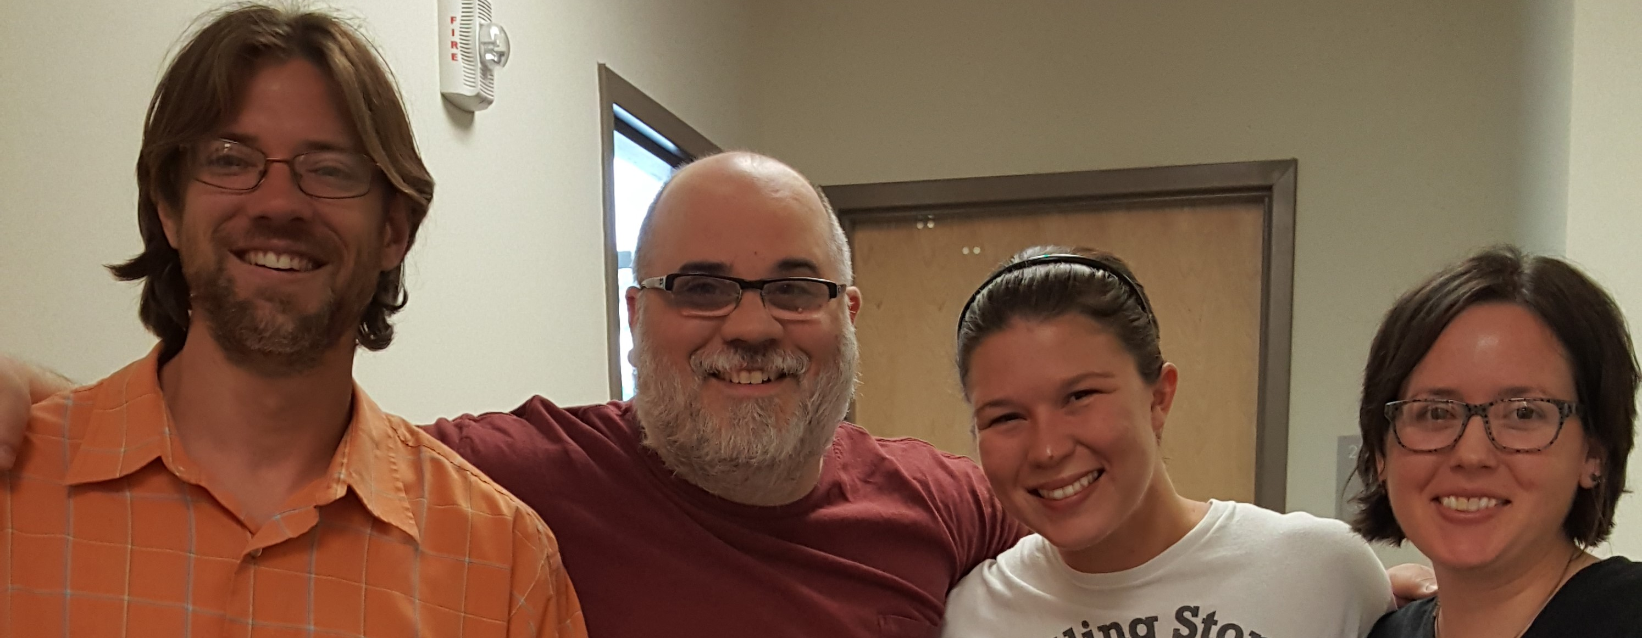
Team: Joseph Comeau, Judy Orton Grissett, Jamie MacLennan
Institution: Georgia Southwestern State University
Course(s): SOCI 1160, SOCI 4440, PSYC 4431
Cost Savings Per Student: $205.00
Report Link: http://oer.galileo.usg.edu/psychology-collections/9/
“Students enjoy not having to purchase a text, and I want to continue to ensure that students are not burdened by purchasing a text. I am also more conscious of my teaching style and materials, since I am not relying on a commercial text and ancillary materials.”

Slide 33
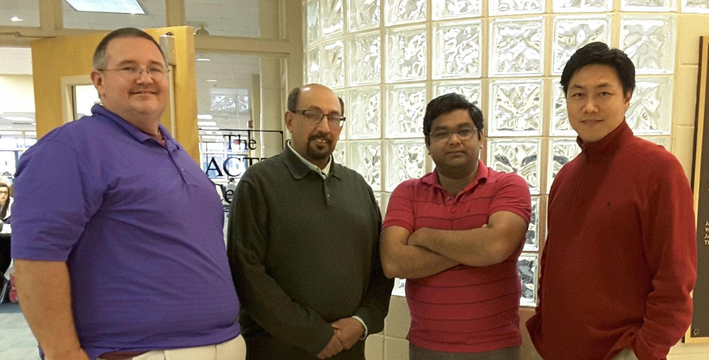
Team: Minsu Kim, Hashim Saber, Bikash Das, Thomas Hartfield
Institution: University of North Georgia
Course(s): MATH 1111, MATH 1113, MATH 2400, MATH 2460
Cost Savings Per Student: $156.75
Report Link: http://oer.galileo.usg.edu/mathematics-collections/16/
“Our team felt that this project has given them the freedom from the restriction of using one assigned textbook and gave them the opportunity to improve education quality and student’s learning by providing easy access to not just one, but several valuable textbooks and supplement materials with zero or minimal cost to students.”

Slide 34
An initiative of the University System of Georgia and GALILEO, Georgia’s Virtual Library

Slide 35
Projects to Support College Affordability
Affordable Learning Georgia provides faculty with the support they need to implement Open Educational Resources (OER), library resources, and other affordable resources in place of a commercial textbook through Textbook Transformation Grants. Faculty also create revisions of existing OER and new ancillary materials through ALG Mini-Grants.
A One-Stop Center for Affordable Resources
Affordable Learning Georgia’s website provides a place for training, search tools, a weekly newsletter, research, reports, and requests for proposals for new rounds of Textbook Transformation Grants: www.affordablelearninggeorgia.org.
A Community of Practice
Affordable Learning Georgia Campus Champions and Library Coordinators help raise awareness of Open Educational Resources to faculty, and help interested faculty in finding, evaluating, revising, remixing, and even creating new OER.

Slide 36
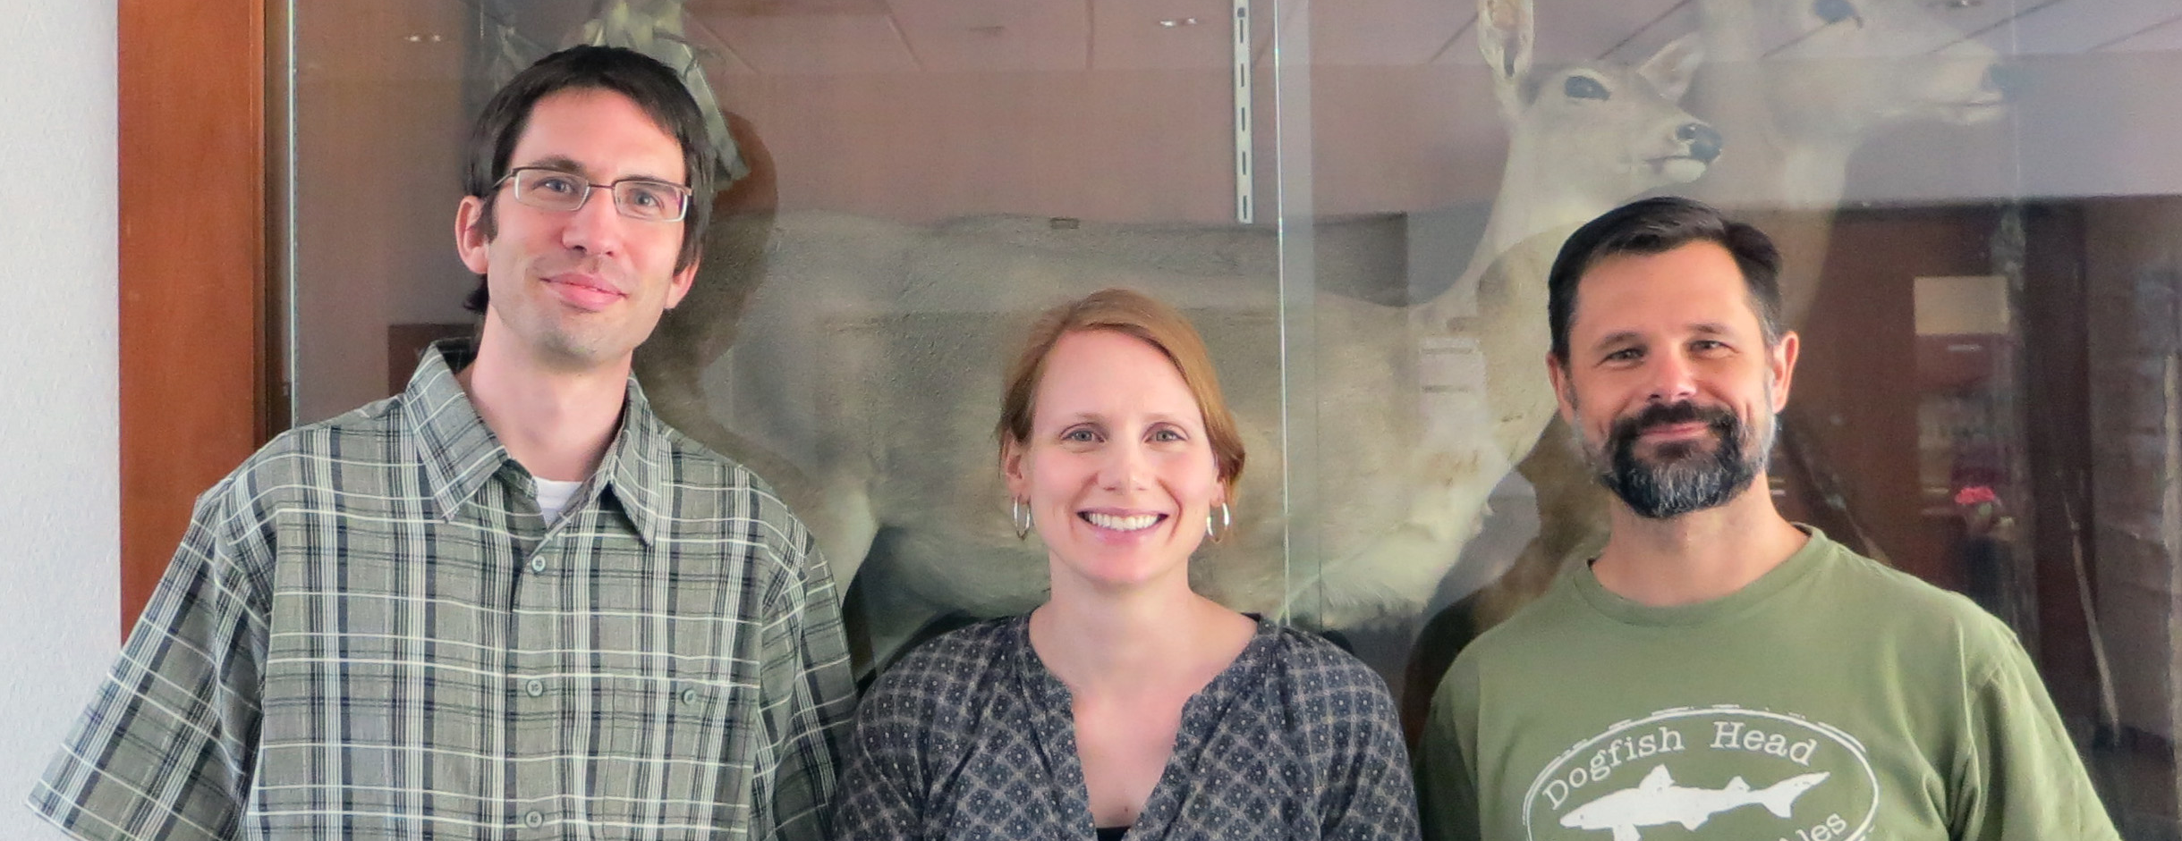
Team: Timothy Henkel, Emily Croteau, Matthew Waters
Institution: Valdosta State University
Course(s): BIOL 1010, BIOL 1030
Cost Savings Per Student: $89.00
Report Link: http://oer.galileo.usg.edu/biology-collections/6/
"I think having the free textbook online is an amazing idea. Students already pay enough money for tuition and other fees, and taking off fees for textbooks is such a stress-reliever. I would love if more classes had their textbooks online, especially ones that we actually use in class like this one. It was extremely beneficial in helping study and understand concepts." -Student

Slide 37
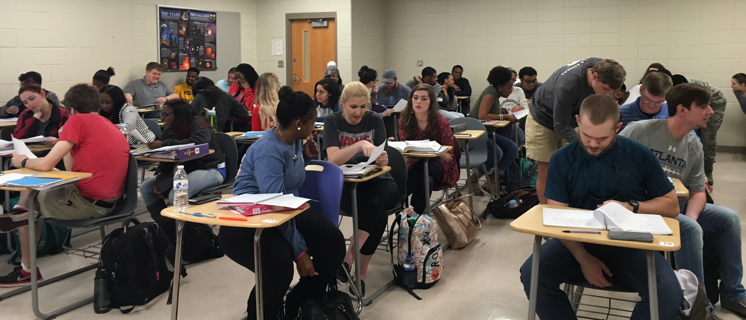
Team: Dereth J. Drake, Shantanu Chakraborty, Michael Holt
Institution: Valdosta State University
Course(s): PHYS 1111, PHYS 1112
Cost Savings Per Student: $256.00
Report Link: http://oer.galileo.usg.edu/physics-collections/2/
"I feel like the text book was very helpful, it allowed me to understand the material better after reviewing my notes each day after class. I would encourage any student who will be taking this class to purchase the textbook or use the online version." -Student

Slide 38
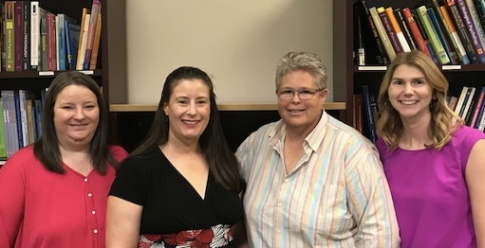
Team: Christopher K. Randall, Jen Willard, Beth Kirsner, Adrienne Williamson, Tricia Mahaffey
Institution: Kennesaw State University
Course(s): PSYC 2000, PSYC 2300, PSYC 3301
Cost Savings Per Student: $297.00
Report Link: http://oer.galileo.usg.edu/psychology-collections/14
“I never once felt like I needed a [commercial] textbook to supplement the material you provided.” -Student

Slide 39
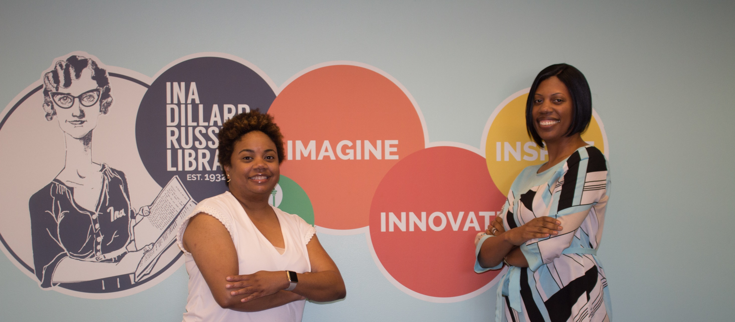
Team: Chavonda Mills, Shaundra Walker
Institution: Georgia College and State University
Course(s): CHEM 3711, 3712, 3510
Cost Savings Per Student: $303.50
Report Link: http://oer.galileo.usg.edu/chemistry-collections/6/
“Overall, the course transformation was a success. As reported in section 3 of this report, a comparison of DFW rates, American Chemical Society standardized test scores, and student self‐reflections were used to determine the impact of the no‐cost course transformation.”

Slide 40
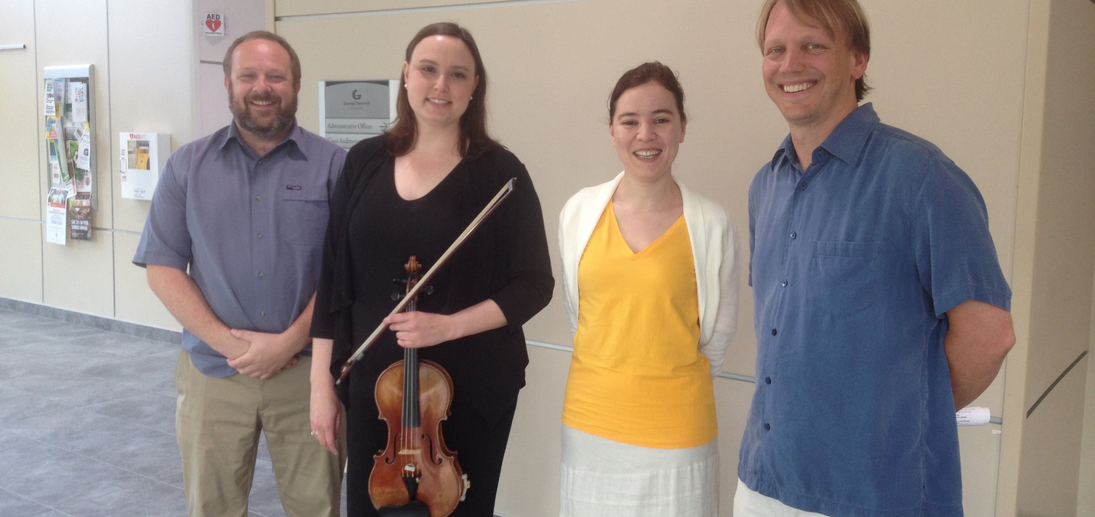
Team: Elizabeth Whittenburg Ozment, Irina Escalante-Chernova, Catherine Kilroe-Smith, Todd Mueller
Institution: Georgia Gwinnett College
Course(s): MUSC 1100
Cost Savings Per Student: $142.85
Report Link: http://oer.galileo.usg.edu/arts-collections/3/
"Brilliant Idea! Saved us money, and study guides were very user friendly." -Student

Slide 41
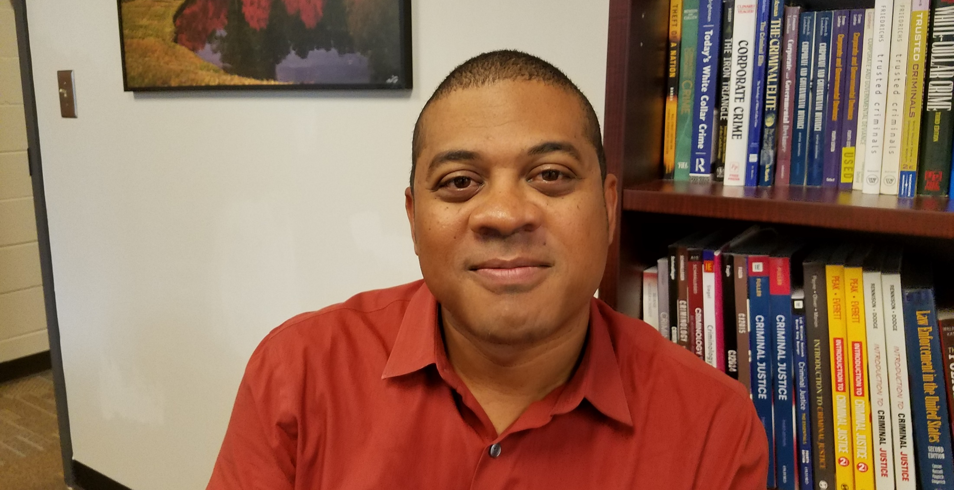
Team: Jason Davis, Andrea Allen, Scott Jacques
Institution: Clayton State University and Georgia State University
Course(s): CRJU 1150, 1100
Cost Savings Per Student: $144.75
Report Link: http://oer.galileo.usg.edu/criminal-collections/2/
“This grant transformed us as instructors by showing us that you do not have to teach with - and to - a textbook.”

Slide 42
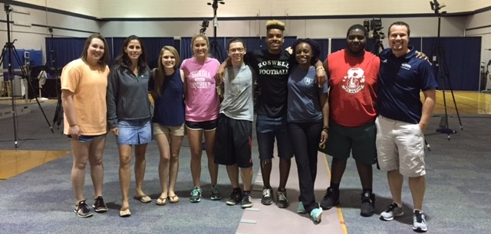
Team: Bridget Melton, Nicholas Murray
Institution: Georgia Southern University
Course(s): KINS 2535
Cost Savings Per Student: $166.00
Report Link: http://oer.galileo.usg.edu/health-collections/4/
“The process of tailor making content material for the course improved the pedagogical and integrity of the course. When we selected each element for the content, the team members really had to ask if it added value to the learning experience.”

Slide 43
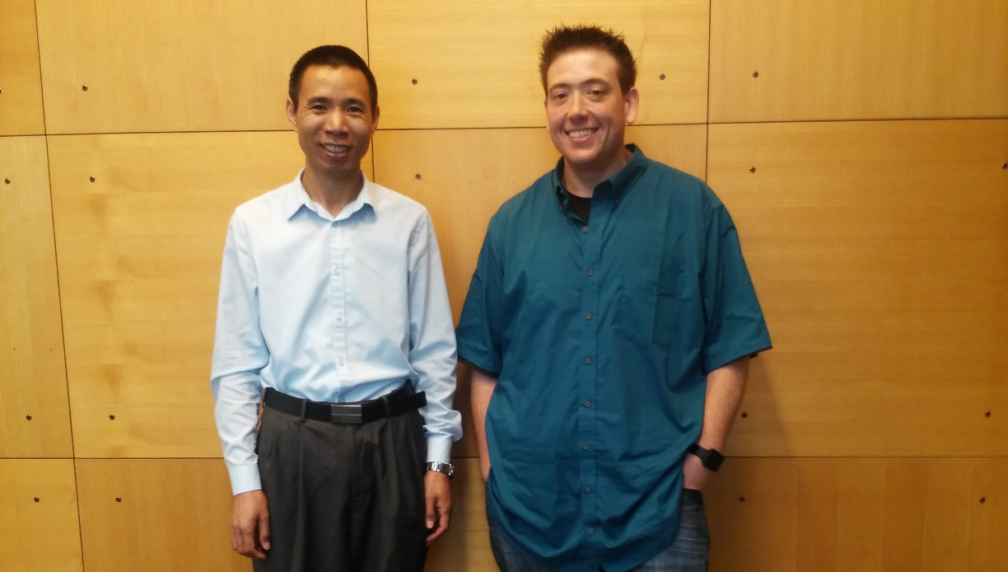
Team: Billie May, Kara Mullen, Jelinda Spotorno, Chaogui Zhang, Aaron Rafter
Institution: Clayton State University
Course(s): MATH 1111, 1112, 1113
Cost Savings Per Student: $189.99
Report Link: http://oer.galileo.usg.edu/mathematics-collections/20/
“We believe that we did achieve our goals, and students are generally satisfied, after overcoming some initial transitional issues.”

Slide 44
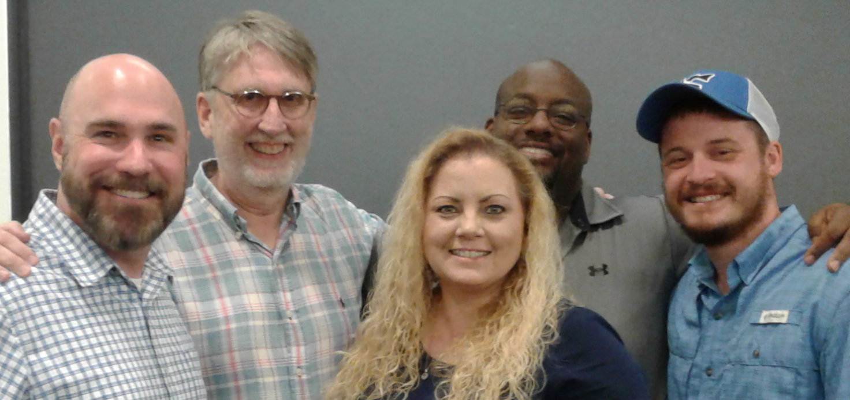
Team: Thomas Harnden, Andrew Dawson, Sharryse Henderson, Jason Christian, Christen Collins, Amanda West
Institution: Georgia Highlands College
Course(s): BIOL 1010, 2154
Cost Savings Per Student: $361.00
Report Link: http://oer.galileo.usg.edu/biology-collections/10/
“Additionally, faculty reported having an increased awareness regarding the various limitations that contemporary students face as well as developed a sense of exigency to create curriculum and activities with these limitations in mind.”

Slide 45
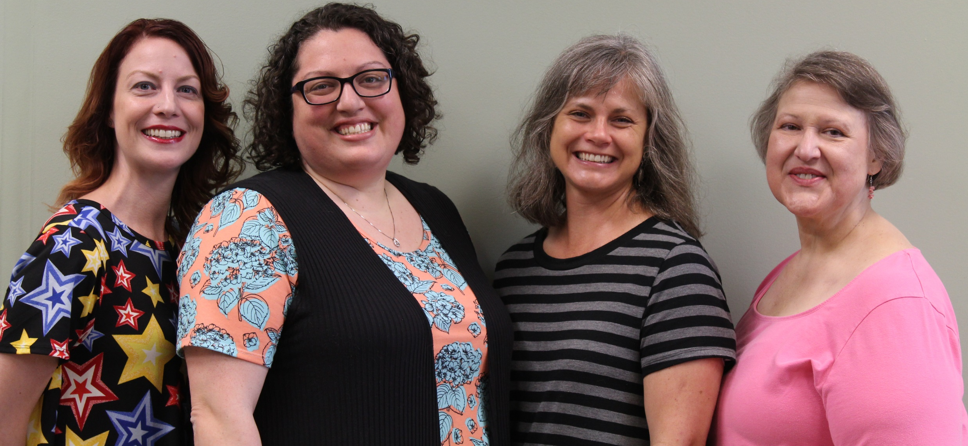
Team: Georgina Hammock, Quentin Hartmann, Lauren Verlaque, Stephanie Northington, Winona Hatcher, Li Ma
Institution: Augusta University
Course(s): PSYC 1101
Cost Savings Per Student: $92.70
Report Link: http://oer.galileo.usg.edu/psychology-collections/17
“We had several accomplishments with our project, the first and foremost being that we accomplished our goal of full implementation across all sections of our Introductory Psychology course in spring 2017. The students were pleased with the money they were able to save on the textbook, and their grades were not negatively impacted by its use.”

Slide 46
An initiative of the University System of Georgia and GALILEO, Georgia’s Virtual Library

Slide 47
Projects to Support College Affordability
Affordable Learning Georgia provides faculty with the support they need to implement Open Educational Resources (OER), library resources, and other affordable resources in place of a commercial textbook through Textbook Transformation Grants. Faculty also create revisions of existing OER and new ancillary materials through ALG Mini-Grants.
A One-Stop Center for Affordable Resources
Affordable Learning Georgia’s website provides a place for training, search tools, a weekly newsletter, research, reports, and requests for proposals for new rounds of Textbook Transformation Grants: www.affordablelearninggeorgia.org.
A Community of Practice
Affordable Learning Georgia Campus Champions and Library Coordinators help raise awareness of Open Educational Resources to faculty, and help interested faculty in finding, evaluating, revising, remixing, and even creating new OER.

Slide 48
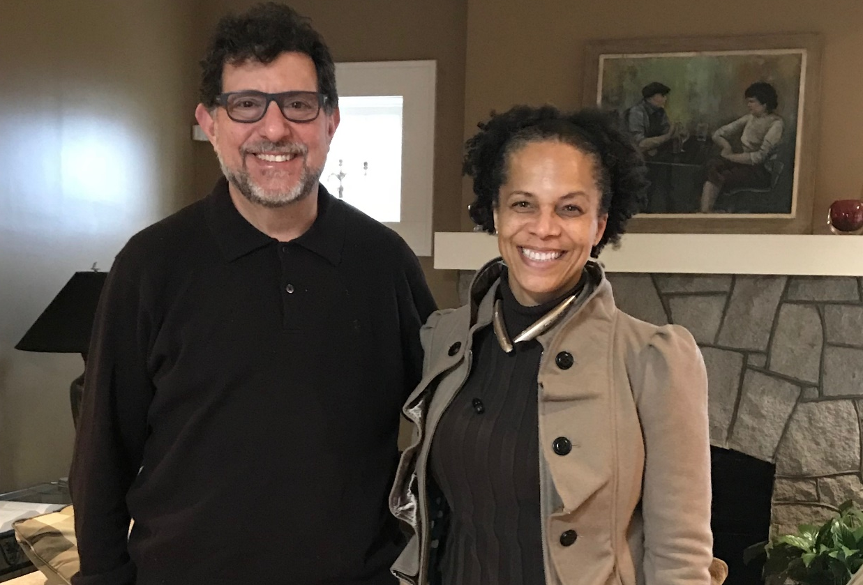
Team: Sheryne Southard, Lawrence Menter
Institution: Clayton State University
Course(s): TECH 3115, BLAW 2106
Cost Savings Per Student: $83.83
Report Link: https://oer.galileo.usg.edu/business-collections/5
“I really appreciate that you have done this. The cost of books are out of control. I have two other classes where my books cost $200 each. I wish all other professors would do this as well. Thank you and I look forward to taking this class.” -Student

Slide 49
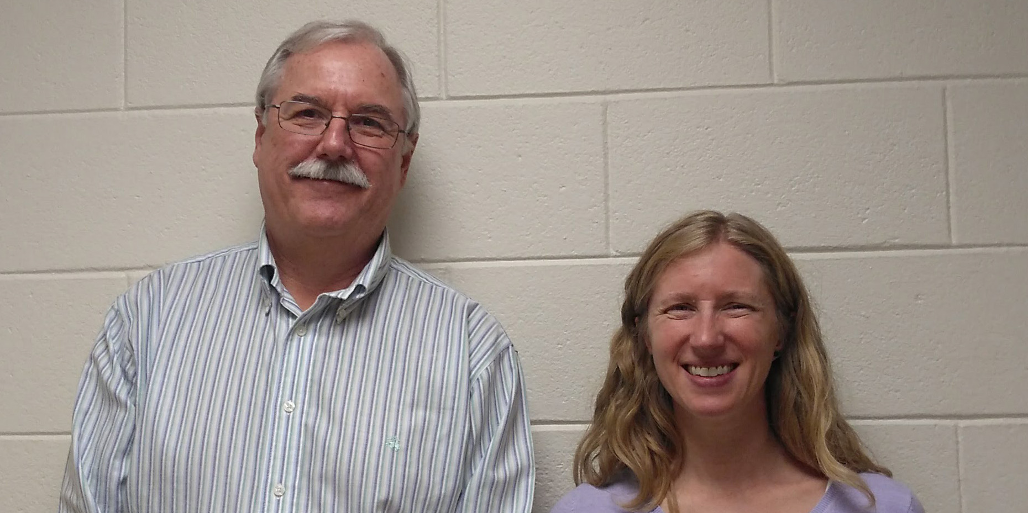
Team: Shana Kerr, David Garten
Institution: Georgia Institute of Technology
Course(s): BIOL 1520, BIOL 1521
Cost Savings Per Student: $180.10
Report Link: https://oer.galileo.usg.edu/biology-collections/14
“As a result of this transformation, instruction in the classroom is now more focused on activities that promote active learning, rather than standard lecture.”

Slide 50
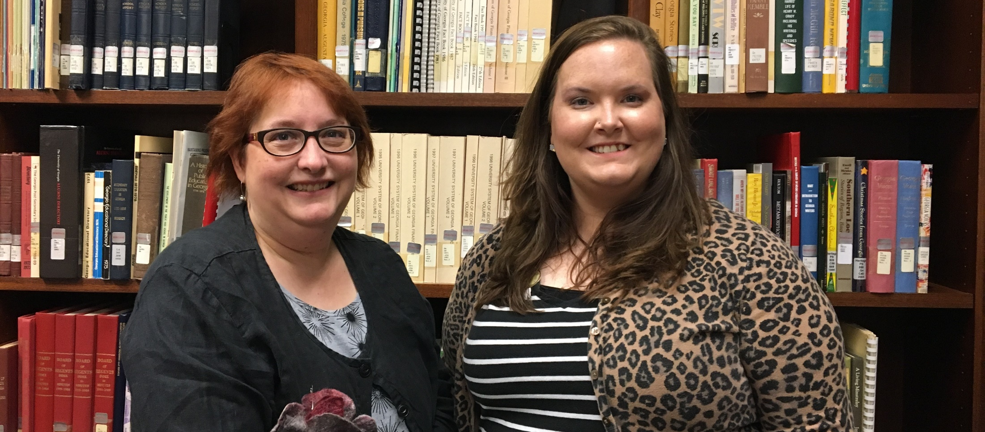
Team: Dee McKinney, Katharine Shepard
Institution: East Georgia State College
Course(s): HIST 1111
Cost Savings Per Student: $200.98
Report Link: https://oer.galileo.usg.edu/history-collections/2
“Overall, the transformation of HIST 1111 with the ALG grant, replacing costly textbooks with OER has been a positive experience. Formal student surveys contained several compliments and expressions of appreciation for the low-cost solution.”

Slide 51
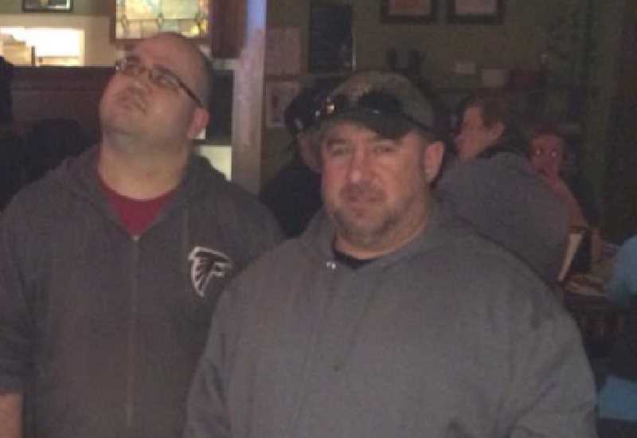
Team: Thomas Gonzalez, Michael Hilgemann, Jason Schmurr
Institution: Dalton State College
Course(s): MATH 2253, MATH 2254, MATH 2255
Cost Savings Per Student: $309.00
Report Link: https://oer.galileo.usg.edu/mathematics-collections/24
“The project resulted in a complete, customized, open source textbook for the calculus sequence at Dalton State College. The textbook source is hosted in such a way that it can be further customized and revised by Dalton State faculty members or by individuals outside of the college.”

Slide 52
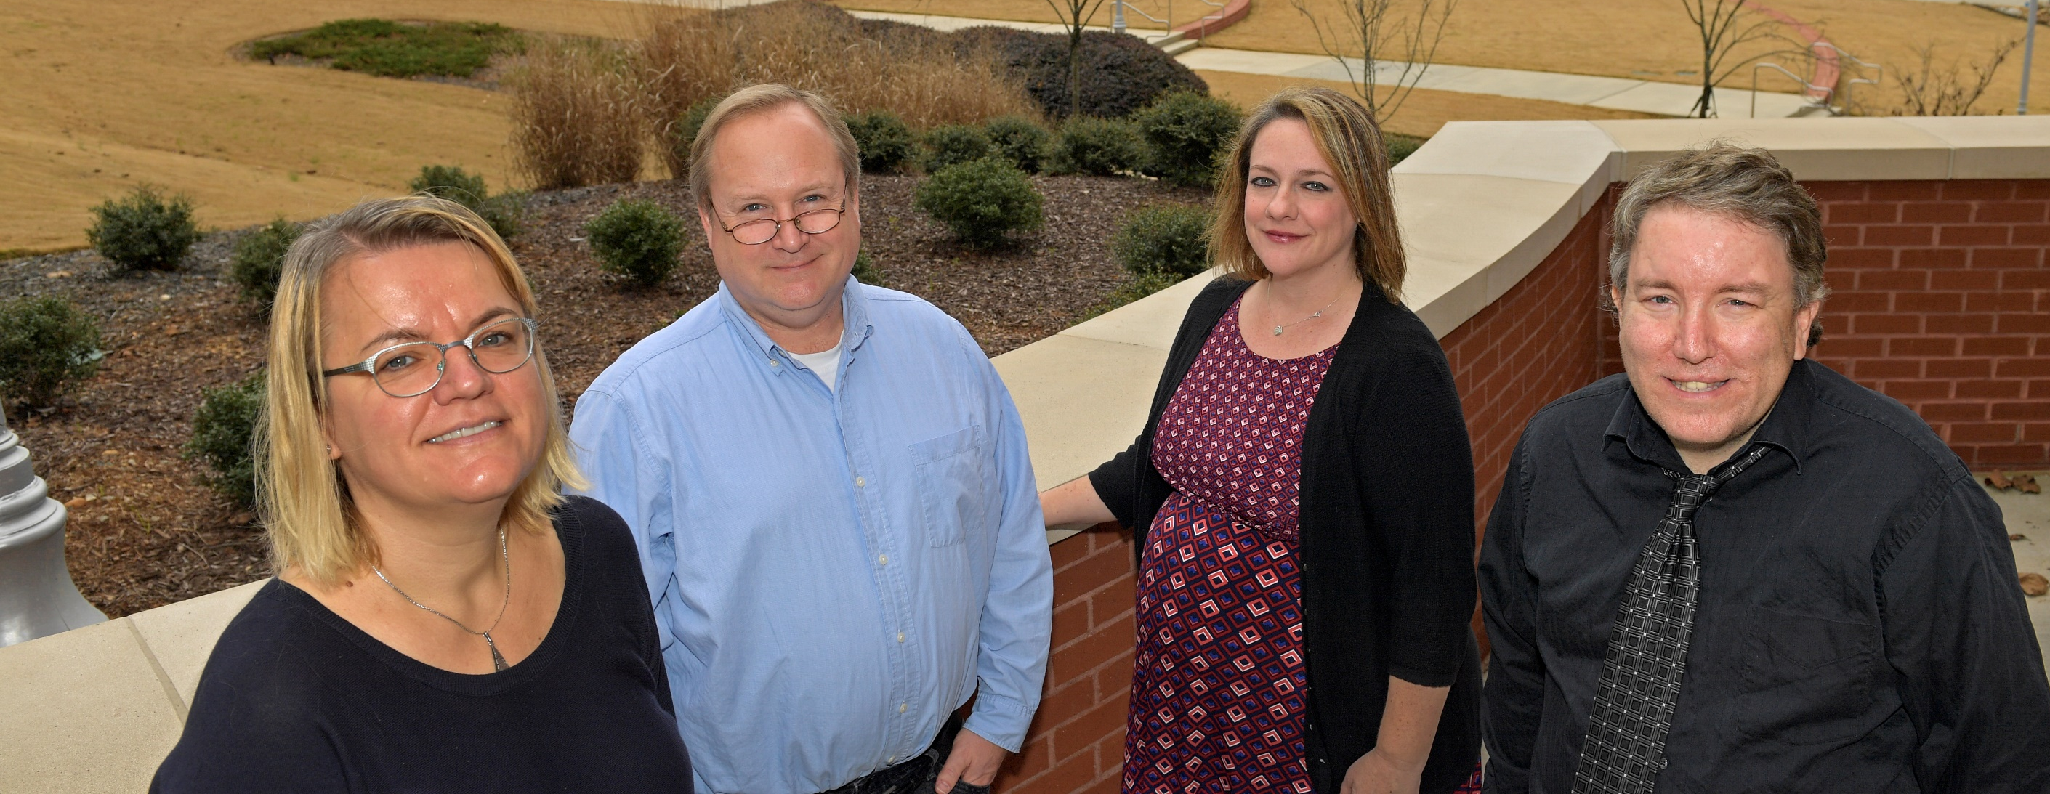
Team: Scott Boykin, Eric Wilk, Michael Lewkowicz
Institution: Georgia Gwinnett College
Course(s): POLS 1101
Cost Savings Per Student: $215.60
Report Link: https://oer.galileo.usg.edu/polisci-collections/3
“Students were more engaged in class and were more likely to attend class lectures because the classes were more interactive... Several students commented the activities helped them better understand the material, and kept the material interesting.”

Slide 53
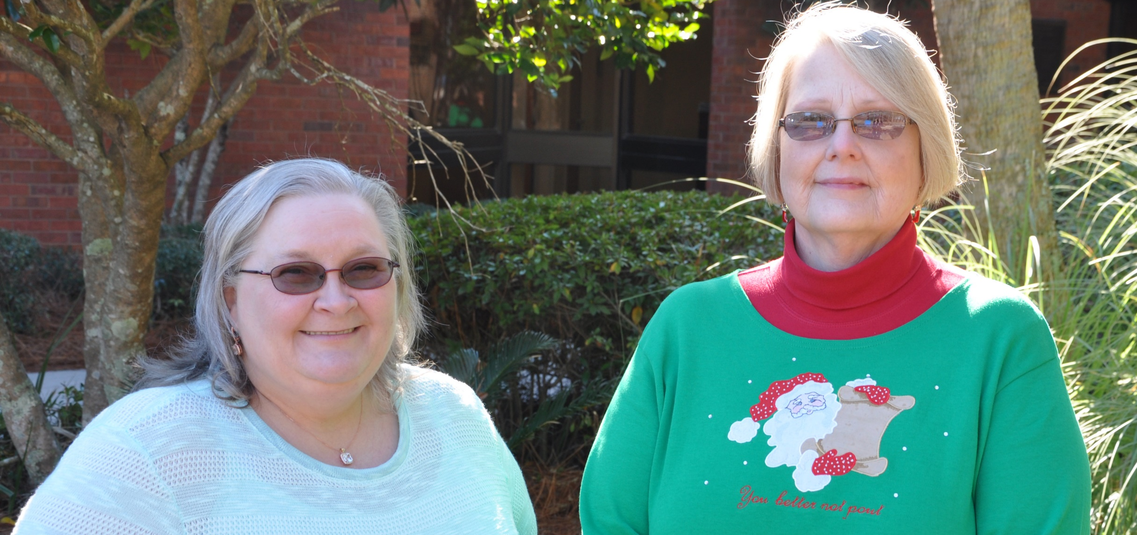
Team: Molly Smith, Sara Selby
Institution: South Georgia State College
Course(s): BIOL 2215
Cost Savings Per Student: $307.80
Report Link: https://oer.galileo.usg.edu/biology-collections/15/
“One of the most personally satisfying accomplishments was the transformation of the method of delivery of the course, from traditional lecture format to a blended/hybrid delivery.”

Slide 54
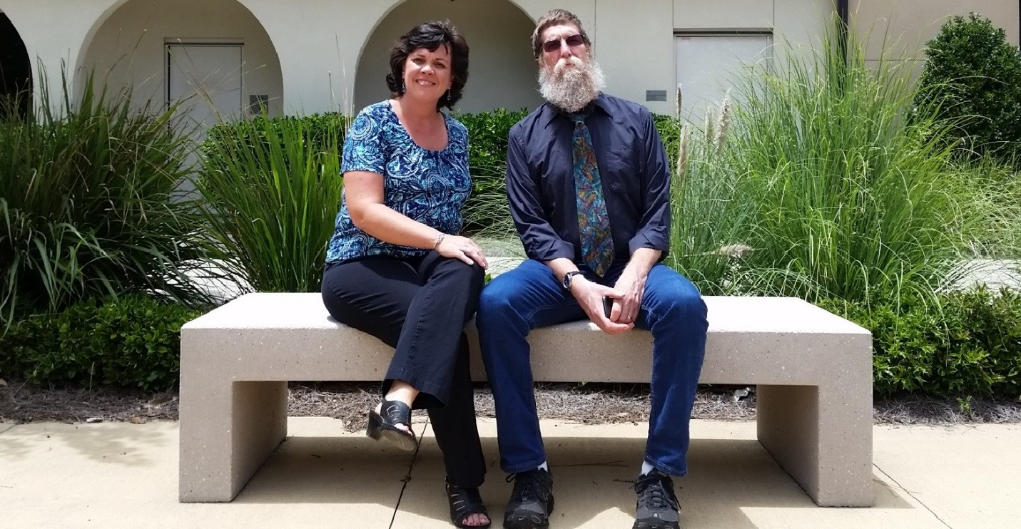
Team: Brian Pope, Lisa McNeal
Institution: College of Coastal Georgia
Course(s): PSYC 1101
Cost Savings Per Student: $223.20
Report Link: https://oer.galileo.usg.edu/psychology-collections/19/
“...the audio and video content developed for this project gives me a degree of flexibility in terms of the delivery format I use (on-site, hybrid, completely on-line). It is a good foundation on which I can build additional content and web-based interactive exercises.”

Slide 55
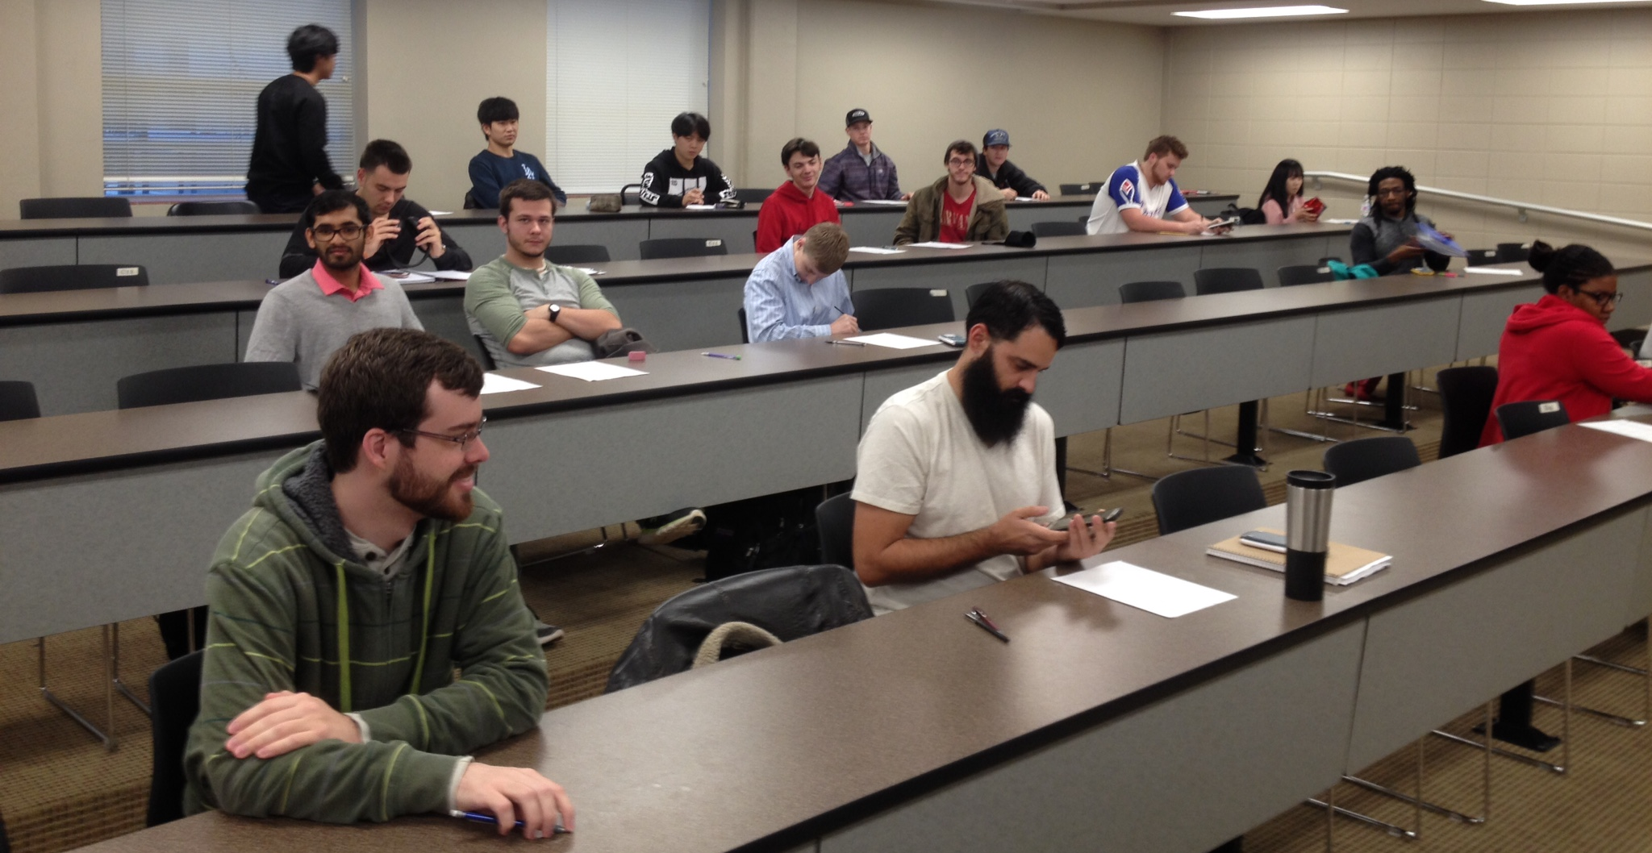
Team: Francis Flaherty, Dereth Drake, Michael Holt
Institution: Valdosta State University
Course(s): PHYS 2211
Cost Savings Per Student: $352.00
Report Link: https://oer.galileo.usg.edu/physics-collections/6/
“The text book and homework sets were very helpful. I would encourage any student who will be taking this class to download the online version. It was handy to have all of the material on my laptop.” -Student

Slide 56
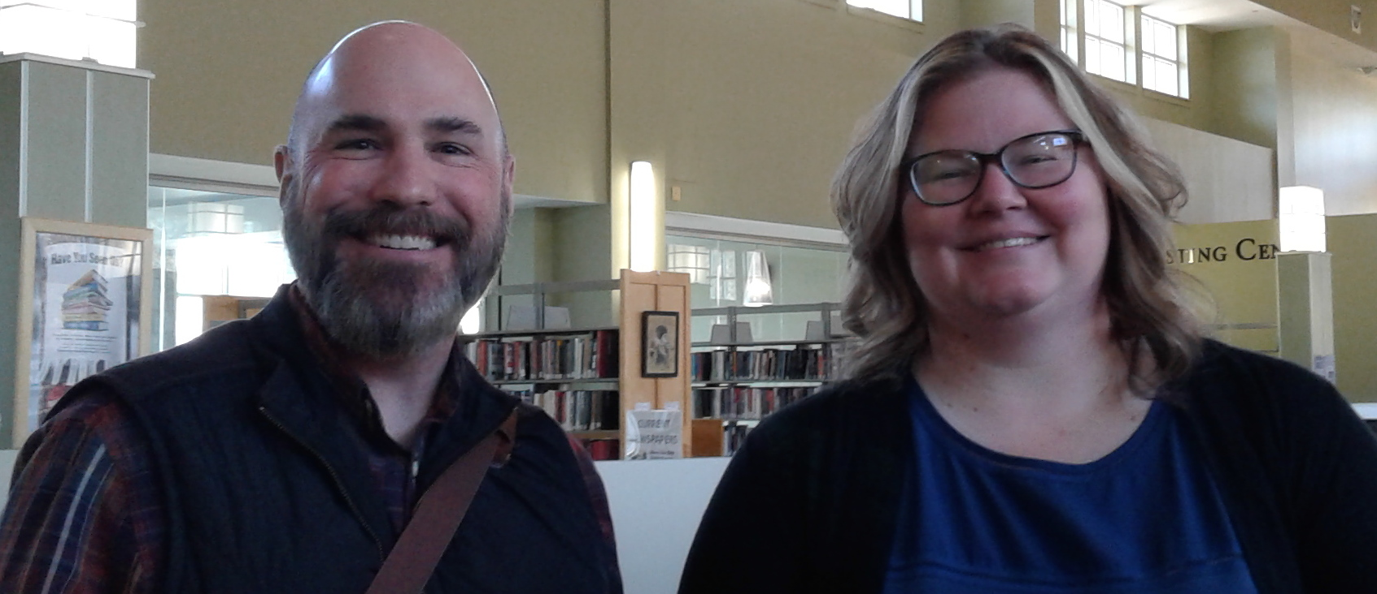
Team: Thomas Harnden, Katie Bridges
Institution: Georgia Highlands College
Course(s): BIOL 1020
Cost Savings Per Student: $222.33
Report Link: https://oer.galileo.usg.edu/biology-collections/16/
“The division of Natural Sciences and Physical Education at Georgia Highlands College is committed to using free or low cost materials to support effective and affordable learning to students. With that said, the division will continue to use the current material as well as add more sources into the Libguide created for this course.”

Slide 57
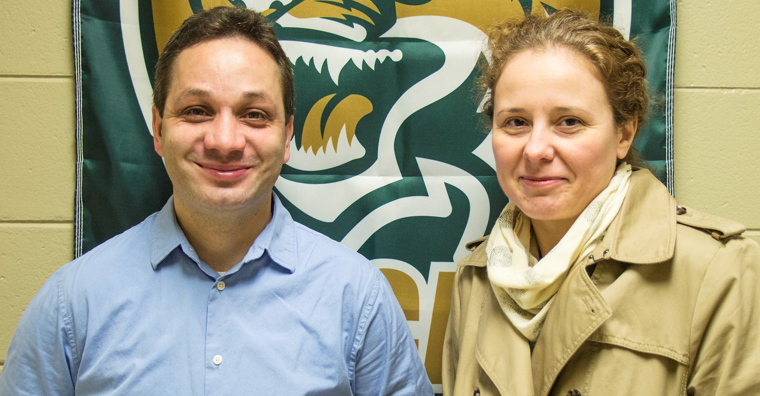
Team: Martiana Sega, David Chevalier
Institution: East Georgia State College
Course(s): BIOL 1107
Cost Savings Per Student: $237.00
Report Link: https://oer.galileo.usg.edu/biology-collections/17
"My favorite experience with the online textbook was that it was free, and available on-the-go. I could pull it up on my phone if I needed to and had the luxury of not having to carry around a big paper hard back book with me around everywhere.“ -Student

Slide 58
An initiative of the University System of Georgia and GALILEO, Georgia’s Virtual Library

Slide 59
Projects to Support College Affordability
Affordable Learning Georgia provides faculty with the support they need to implement Open Educational Resources (OER), library resources, and other affordable resources in place of a commercial textbook through Textbook Transformation Grants. Faculty also create revisions of existing OER and new ancillary materials through ALG Mini-Grants.
A One-Stop Center for Affordable Resources
Affordable Learning Georgia’s website provides a place for training, search tools, a weekly newsletter, research, reports, and requests for proposals for new rounds of Textbook Transformation Grants: www.affordablelearninggeorgia.org.
A Community of Practice
Affordable Learning Georgia Campus Champions and Library Coordinators help raise awareness of Open Educational Resources to faculty, and help interested faculty in finding, evaluating, revising, remixing, and even creating new OER.

Slide 60
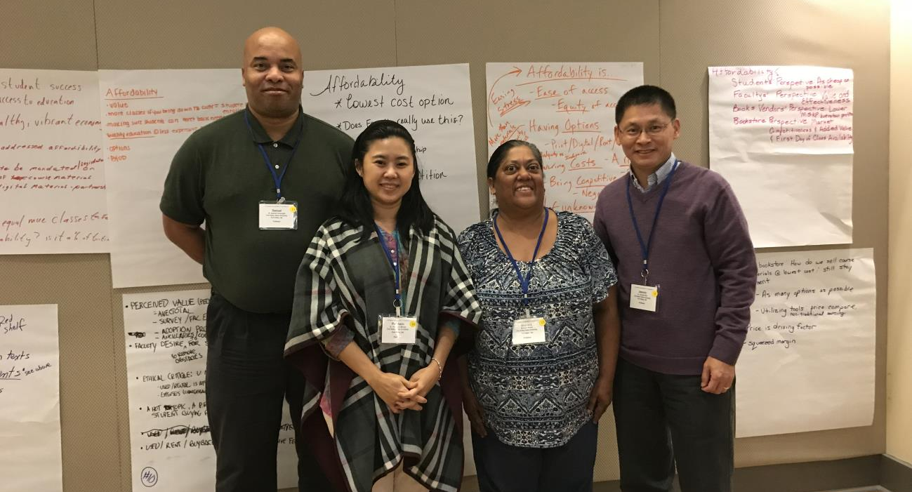
Team: Samuel Cartwright, Patcharin Marion, Bhavana Burell, Jianmin Zhu
Institution: Fort Valley State University
Course(s): MATH 1154, MATH 2164, MATH 1150, MATH 3233
Cost Savings Per Student: $268.00
Report Link: https://oer.galileo.usg.edu/mathematics-collections/26
“This project had positive influence on our thinking in terms of teaching and learning. The process of using D2L to create materials and organize materials for students to learn has provided a foundation to build on. That is, for creating more similar materials and well as taking what works and building upon for future use in the improvement of the course design.”

Slide 61
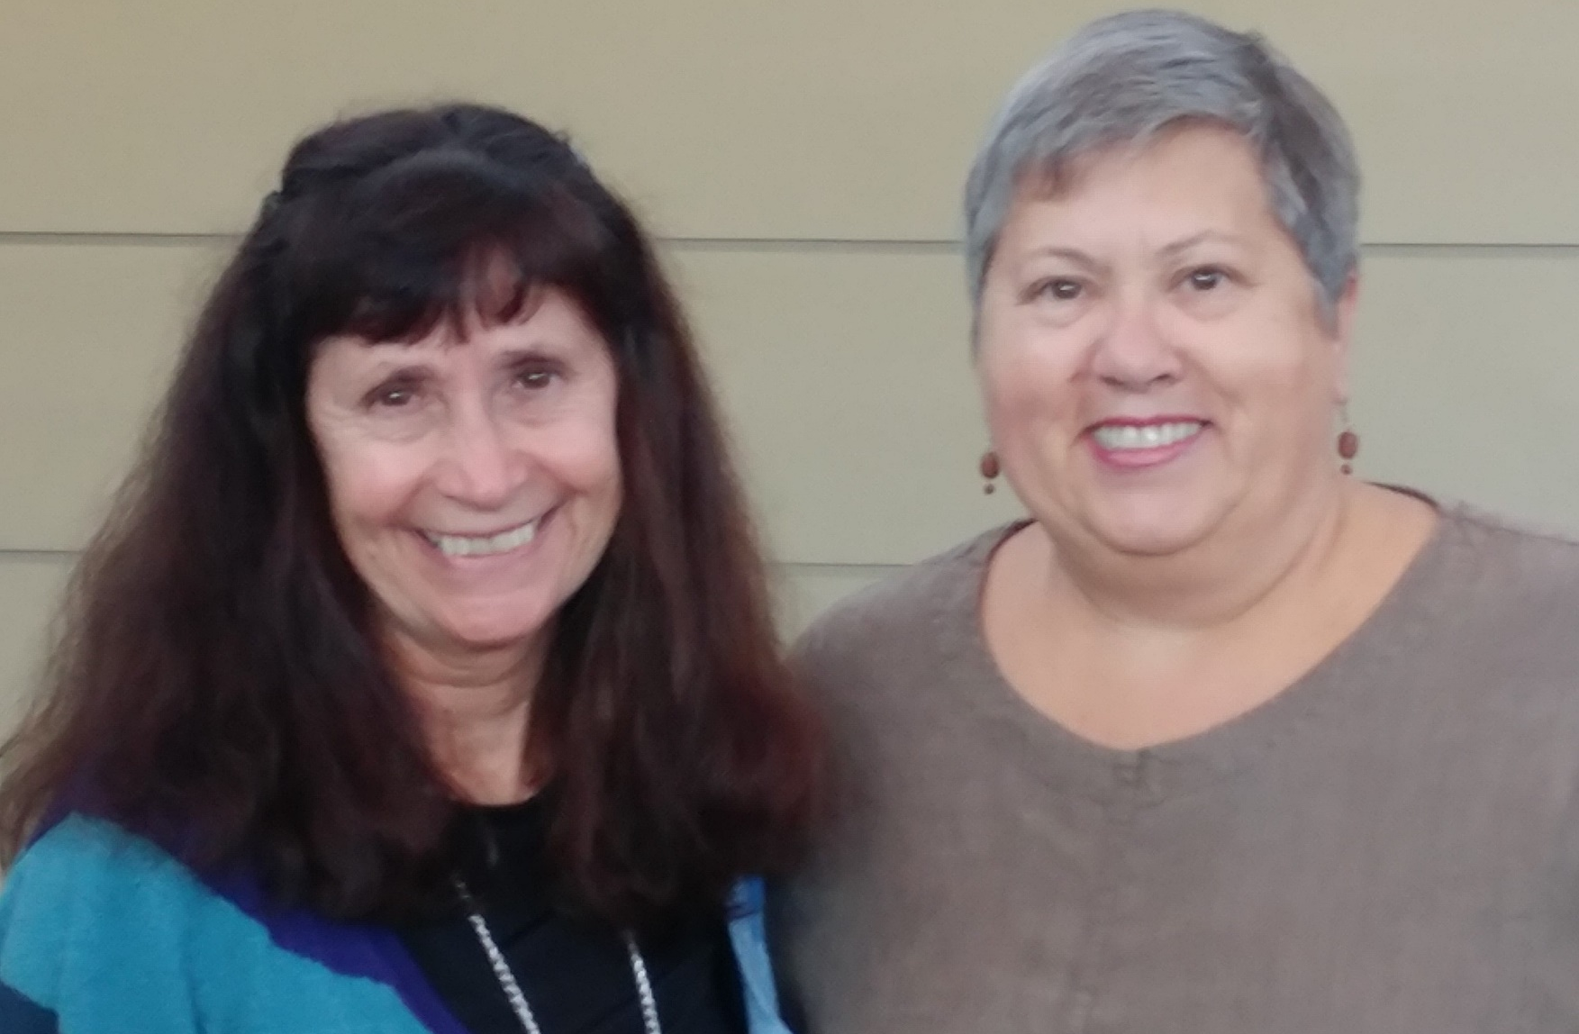
Team: Barbara Hall, Elizabeth Wallace
Institution: Georgia State University
Course(s): ENSL 0081, ENSL 0091
Cost Savings Per Student: $182.50
Report Link: https://oer.galileo.usg.edu/english-collections/4
“The etext is good because it is free and you can just go to the class without carrying a heavy book around, especially if your class is in a computer lab like mine was. It has great resources for students like me.” -Student

Slide 62
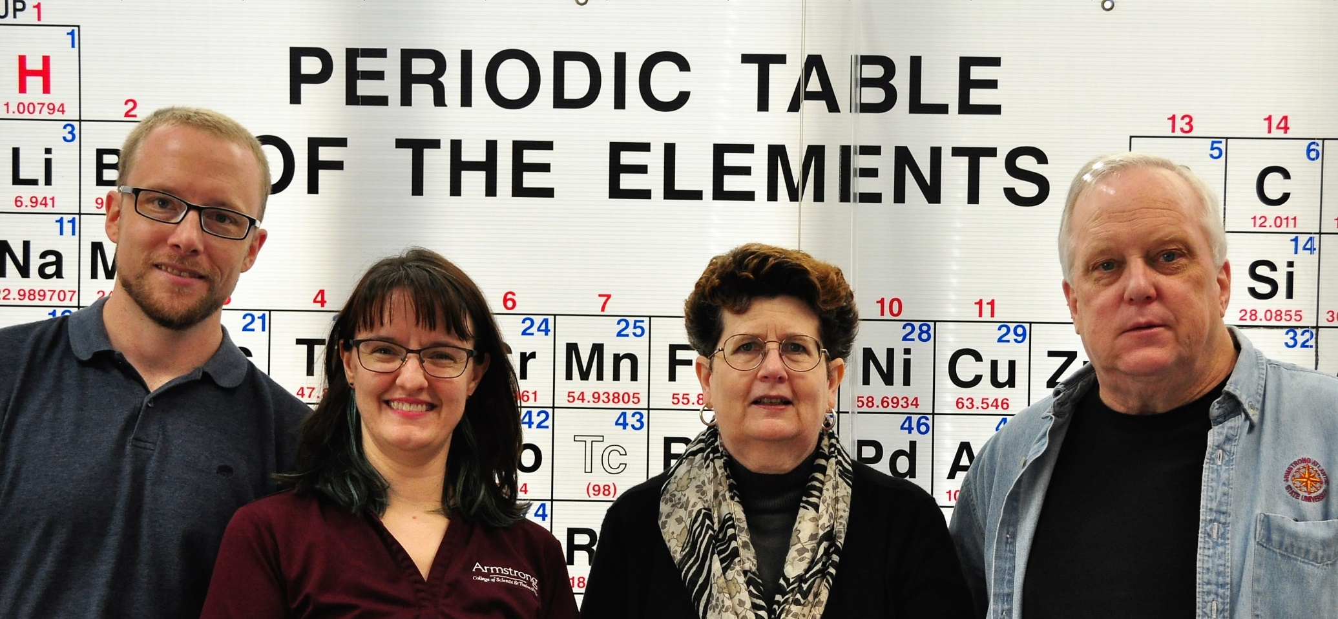
Team: Lea Padgett, Catherine MacGowan, Gary Guillet, Todd Hizer
Institution: Georgia Southern University
Course(s): CHEM 1211, CHEM 1212
Cost Savings Per Student: $215.69
Report Link: https://oer.galileo.usg.edu/chemistry-collections/15
“The team members did experience some professional development opportunities in preparing lecture materials under the guidelines of Creative Commons licensing and 504 compliance. The development of surveys and resulting discussions on the analysis of the data with a skilled evaluator at our institution are also areas in which the project team experienced individual growth.”

Slide 63

Team: Hashim Saber, Piotr Hebda, Beata Hebda, Benkam Bobga
Institution: University of North Georgia
Course(s): MATH 1450, MATH 2470, MATH 3650
Cost Savings Per Student: $279.80
Report Link: https://oer.galileo.usg.edu/mathematics-collections/29
“The use of WeBWorK to develop the homework and quizzes was thoughtful and allowed for ease of grading, supplementing the textbook homework and quizzes, and continued support and implementation for future courses. Students expressed a more positive and satisfactory opinion about the course having a free textbook and a free or reduced cost homework program available to them from day one of the semester.”

Slide 64

Team: Scott Flynn, Lisa Jellum, Althea Moser, Jonathan Howard, Sharryse Henderson, Christin Collins, Amanda West, David Mathis
Institution: Georgia Highlands College
Course(s): PHED 1010, PHED 1130
Cost Savings Per Student: $111.00
Report Link: https://oer.galileo.usg.edu/health-collections/5
“The excitement of this project was generated from the opportunity to genuinely help make our student’s education more affordable by creating a free textbook. Throughout the process of creating the textbook, we feel like we’ve been able to keep much of the same [type of content] as traditional textbooks, present it in an understandable way, and offer it in a format that students could easily access.”

Slide 65

Team: Da'Mon Andrews, Antre' Drummer
Institution: Clayton State University
Course(s): MATH 0989
Cost Savings Per Student: $180.63
Report Link: http://oer.galileo.usg.edu/mathematics-collections/23/
“Overall the project was a success. Student outcomes were better than those of prior semesters and consistent with those of non-ALG courses during the implementation period. Based on this project, we have optimism that no-cost course materials can provide significant cost savings to students without diminishing course success rates.”

Slide 66

Team: Larry Gibson, Valerie Fambrough
Institution: University of North Georgia
Course(s): BIOL 2120, BIOL 2130
Cost Savings Per Student: $285.58
Report Link: https://oer.galileo.usg.edu/biology-collections/18
“I can without reservation state that using the free OpenStax A&P textbook was a positive thing for both my students and in the matter of making my institution a more affordable place for a student to obtain an education goal.”

Slide 67

Team: Christopher Ward, David Gilbert
Institution: Clayton State University
Course(s): HIST 1111
Cost Savings Per Student: $125.00
Report Link: https://oer.galileo.usg.edu/history-collections/3
“I adore the use of open source textbooks and this particular text was really well written and put together.” -Student

Slide 68

Team: Scott Kersey, Stephen Carden
Institution: Georgia Southern University
Course(s): MATH 1441, STAT 2231
Cost Savings Per Student: $168.00
Report Link: https://oer.galileo.usg.edu/mathematics-collections/33
"The [WeBWorK open-source] homework being free, as well as allowing multiple attempts, taught me how to solve problems more confidently. The layout of the notes was extremely neat and made focusing on the main points a breeze!" -Student

Slide 69
An initiative of the University System of Georgia and GALILEO, Georgia’s Virtual Library

Slide 70
Projects to Support College Affordability
Affordable Learning Georgia provides faculty with the support they need to implement Open Educational Resources (OER), library resources, and other affordable resources in place of a commercial textbook through Textbook Transformation Grants. Faculty also create revisions of existing OER and new ancillary materials through ALG Mini-Grants.
A One-Stop Center for Affordable Resources
Affordable Learning Georgia’s website provides a place for training, search tools, a weekly newsletter, research, reports, and requests for proposals for new rounds of Textbook Transformation Grants: www.affordablelearninggeorgia.org.
A Community of Practice
Affordable Learning Georgia Campus Champions and Library Coordinators help raise awareness of Open Educational Resources to faculty, and help interested faculty in finding, evaluating, revising, remixing, and even creating new OER.

Slide 71

Team: David Dorrell, Todd Lindley, Georgeta Connor, Joseph Henderson, James Lowry
Institution: Georgia Gwinnett College
Course(s): GEOG 1101
Cost Savings Per Student: $136.60
Report Link: https://oer.galileo.usg.edu/geo-collections/1
“Without question the cost burden of attending Introduction to Human Geography at Georgia Gwinnett college has been reduced. This goal was perhaps the easiest to meet in that it did not require that the material be of similar quality as the material that was replaced. Fortunately, as other parts of this document will show, the quality of the new material was sufficient for this course.”

Slide 72

Team: Hongjie Wang, Caroline Hopkinson
Institution: Armstrong State University
Course(s): HIST 1111
Cost Savings Per Student: $83.85
Report Link: https://oer.galileo.usg.edu/history-collections/4
“[The project] has served as a replicable model for the rest of the faculty in the History Department. Quite a few faculty expressed interests in adopting affordable [materials] in their own different classes to lower the cost of textbooks and promote classroom teaching.”

Slide 73

Team: Federica Goldoni, Luis Mora, Stacy Rusnak
Institution: Georgia Gwinnett College
Course(s): SPAN 1001, SPAN 1002
Cost Savings Per Student: $180.00
Report Link: https://oer.galileo.usg.edu/languages-collections/3
“The new material incorporates engaging group projects and interactive activities, uses up-to-date and timely sources, and current multimedia... [it] reflects more closely the needs, interests, and challenges of our unique and highly diverse student body, more so than any commercial textbook for introductory Spanish.”

Slide 74

Team: Amanda Rees, Brad Huff
Institution: Columbus State University
Course(s): GEOG 1101
Cost Savings Per Student: $142.59
Report Link: https://oer.galileo.usg.edu/geo-collections/3
“It was easier to study because she gave us exactly what we needed.” -Student

Slide 75

Team: Constantin Ogloblin, William Levernier, John Brown, John King
Institution: Georgia Southern University
Course(s): ECON 2106
Cost Savings Per Student: $199.00
Report Link: https://oer.galileo.usg.edu/business-collections/6
“...we consider our textbook transformation project a success. We enjoy teaching the course contents tailored to directly target the course learning objectives and hence allowing us to more effectively foster students’ success in achieving them.”

Slide 76

Team: Mark Kunkel, Amelia Bagwell, Rod McCrae
Institution: University of West Georgia
Course(s): PSYC 1101
Cost Savings Per Student: $200.00
Report Link: https://oer.galileo.usg.edu/psychology-collections/20
“The accomplishments included generally positive student [responses], increased student performance and reduced attrition rates, [and] development of a large body of new and novel text material.”

Slide 77

Team: Loleta Sartin, Molly Kimsey, Pat Borck, Robin Grant, Shamani Shikwambi, Lane Brooks, Sherie Owens
Institution: Middle Georgia State University
Course(s): EDUC 2120, EDUC 2130
Cost Savings Per Student: $320.00
Report Link: https://oer.galileo.usg.edu/education-collections/6
“The process was extremely gratifying. To read and hear the students’ responses to the Open Education Resources made the time commitment worthwhile.”

Slide 78

Team: Ching-Yu Huang, Janice Crook-Hill, Andrea Darracq, Hugo Collantes, James Wilkison, Enes Aganovic, Terri Bell
Institution: University of North Georgia
Course(s): BIOL 1102
Cost Savings Per Student: $219.12
Report Link: https://oer.galileo.usg.edu/biology-collections/19
“It was nice having a text book, or essentially an entire class on my back without adding anymore weight than my computer. The availability and access was spectacular and I would prefer to have all of my classes like this one.” -Student

Slide 79

Team: Jayme Feagin, Bronson Long, Steve Blankenship, Katie Bridges, J. Sean Callahan
Institution: Georgia Highlands College
Course(s): HIST 2111, HIST 2112
Cost Savings Per Student: $65.00
Report Link: https://oer.galileo.usg.edu/history-collections/5
“This course was much more straightforward than I had first anticipated, once I found out the textbook was online I was so relieved and this online textbook was easier to use than any other online book I've ever be assigned to.” -Student

Slide 80

Team: Lei Li, Zhigang Li, Hossain Shahriar, Rebecca Rutherfoord, Svetlana Peltsverger, Dawn Tatum
Institution: Kennesaw State University
Course(s): IT 6843, IT 6833, IT 6883, CSE 3801
Cost Savings Per Student: $137.83
Report Link: https://oer.galileo.usg.edu/compsci-collections/8
“Students’ opinions on [the] learning [materials] we created are overwhelmingly positive. Our assessment data shows that, in majority of the section where the no-cost learning material were implemented, students’ performance is either neutral or better comparing to students’ performance in previously taught sections using textbooks.”

Slide 81

Team: Sarah Tesar, Allen Easton, Erin Kingston, Charles Garrison, Joseph Collins, Christin Collins, Sharryse Henderson, Greg Ford
Institution: Georgia Highlands College
Course(s): CHEM 1211, CHEM 1212
Cost Savings Per Student: $180.25
Report Link: https://oer.galileo.usg.edu/chemistry-collections/16
“The OpenStax textbook and ancillary materials had a positive impact on instruction. Instructors of record were able to direct students to videos on difficult topics, and create videos during the semester on topics their students were struggling with.”

