Slide 1



ALG 101: Open Education and Textbook Transformation
Jeff Gallant
Program Manager, Affordable Learning Georgia
June 19, 2018
This presentation is under a Creative Commons Attribution-ShareAlike License (CC BY-SA 4.0).

Slide 2
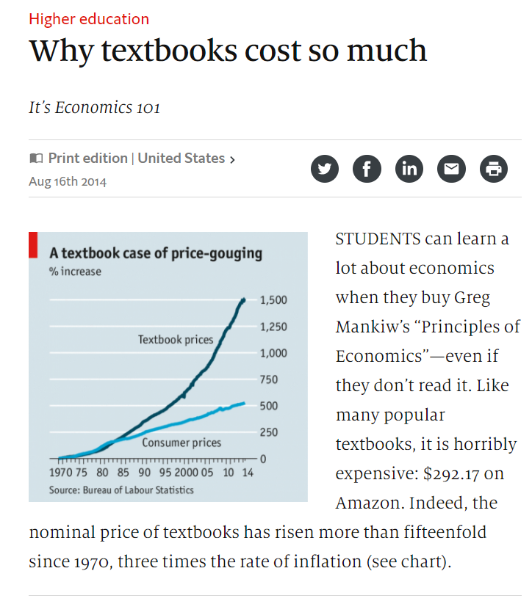
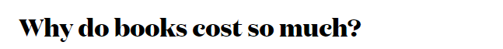
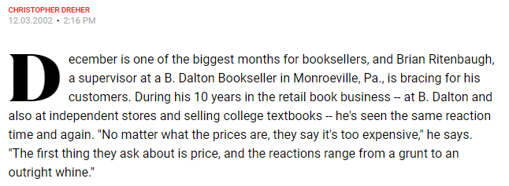
Textbook prices skyrocketed starting in 2000…

Slide 3
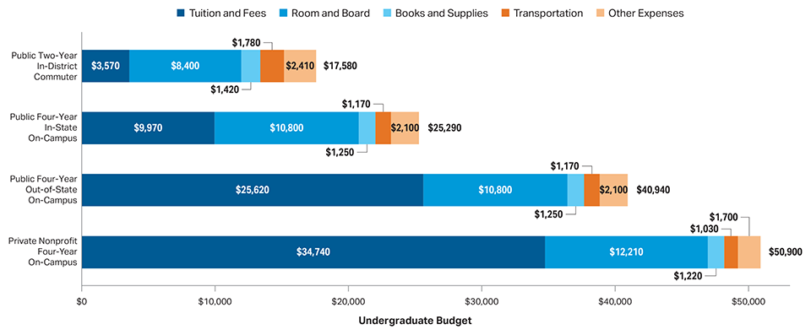
In 2017, financial aid departments expected four-year public college students to spend $1,250 in one year on books and supplies.
This is over 10% of the cost of tuition and fees at a four-year, in-state public institution.
https://trends.collegeboard.org/college-pricing/figures-tables/average-estimated-undergraduate-budgets-2017-18

Slide 4
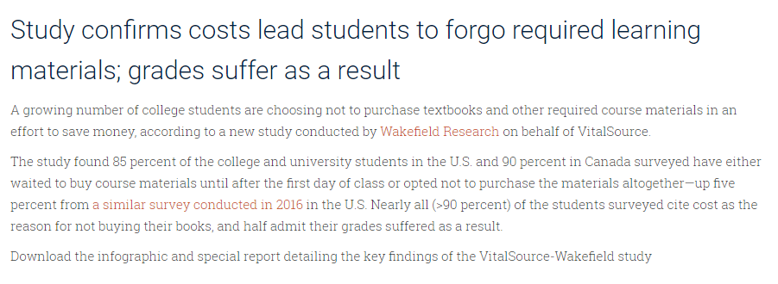
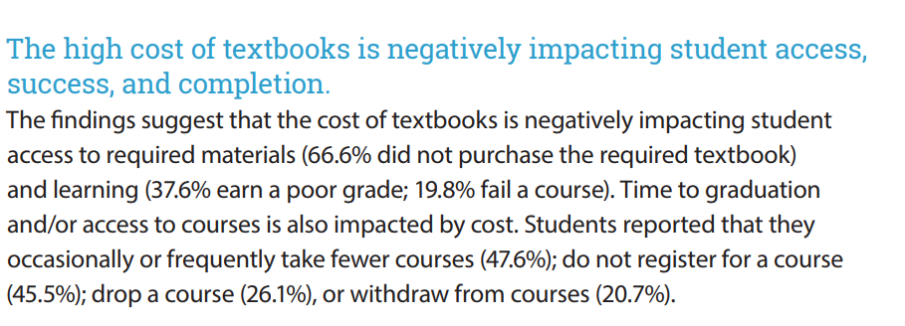
Students are not spending that much on average-
but there’s a higher cost.
https://press.vitalsource.com/study-confirms-costs-lead-students-to-forgo-required-learning-materials-grades-suffer-as-a-result
https://florida.theorangegrove.org/og/file/3a65c507-2510-42d7-814c-ffdefd394b6c/1/2016%20Student%20Textbook%20Survey.pdf

Slide 5
The Open Education movement seeks to enable affordable and new forms of sharing and enhancing education through new forms of teaching.
But what is Open Education?

Slide 6
David Wiley: OER = Free + Permissions
The 5R Permissions of Open
Retain: You can keep the resource without a deadline.
Redistribute: You can send copies of the resource to others or host it on your own publicly-available site.
Revise: You can change, edit, and update the resource.
Remix: You can combine open resources together or put them into new formats.
Reuse: You can use the resource in whichever way you need.
More from David Wiley at opencontent.org

Slide 7

Open Education Values
Open Education enables free digital sharing that copyright prevents
Being able to remix and revise educational resources allows instructors to incorporate new forms of pedagogy that Open allows
http://openedconference.org/2017

Slide 8

Creative Commons Licenses:
The Open Education Licenses
Creative Commons licenses are most easily explained as the open licenses that aren’t based on free software.
All about content

Slide 9
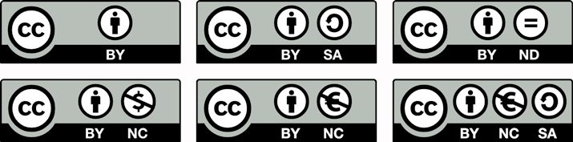
How it Works: Start with Attribution
CC = Creative Commons
BY = Attribution
SA = Share-Alike
NC = Non-Commercial
ND = No Derivatives
  In Open Education, don’t use ND!
https://designshack.net/articles/business-articles/the-simple-guide-to-creative-commons-resources/ by Carrie Cousins

Slide 10
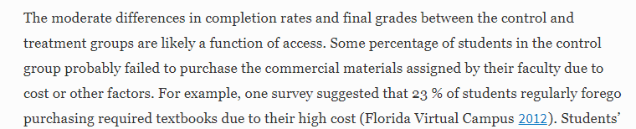
It’s about equity and access.
With OER, everyone in class has free and open access to the same educational materials on day one.
Fischer, L., Hilton, J., Robinson, T.J. et al. J Comput High Educ (2015) 27: 159. https://doi.org/10.1007/s12528-015-9101-x

Slide 11
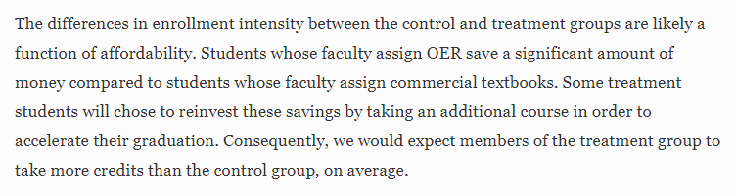
But it’s more than just higher grades.
With college more affordable for students through a reduction or elimination of textbook costs, students may be able to take an additional course.
Fischer, L., Hilton, J., Robinson, T.J. et al. J Comput High Educ (2015) 27: 159. https://doi.org/10.1007/s12528-015-9101-x

Slide 12
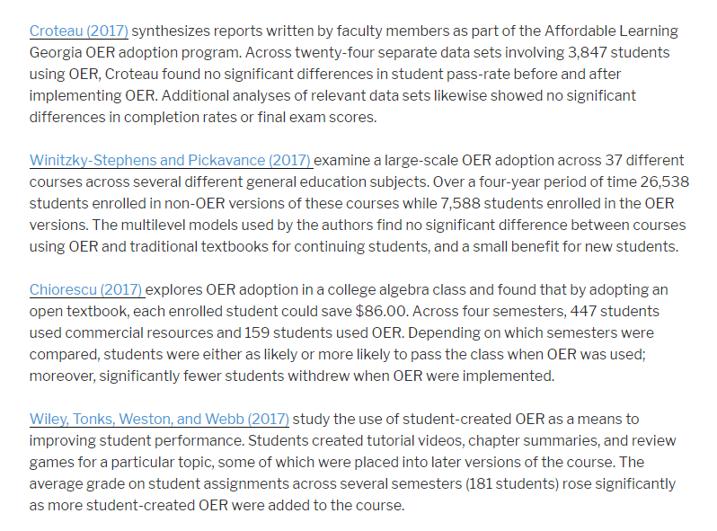
Research, Research, and More Research on Open Pedagogy and OER
http://openedgroup.org/

Slide 13
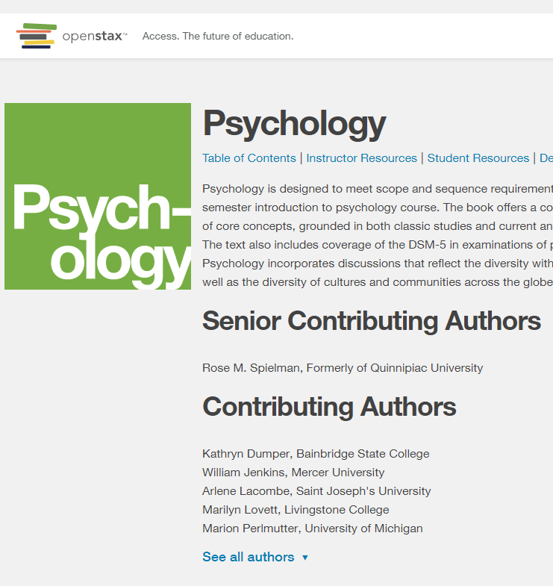
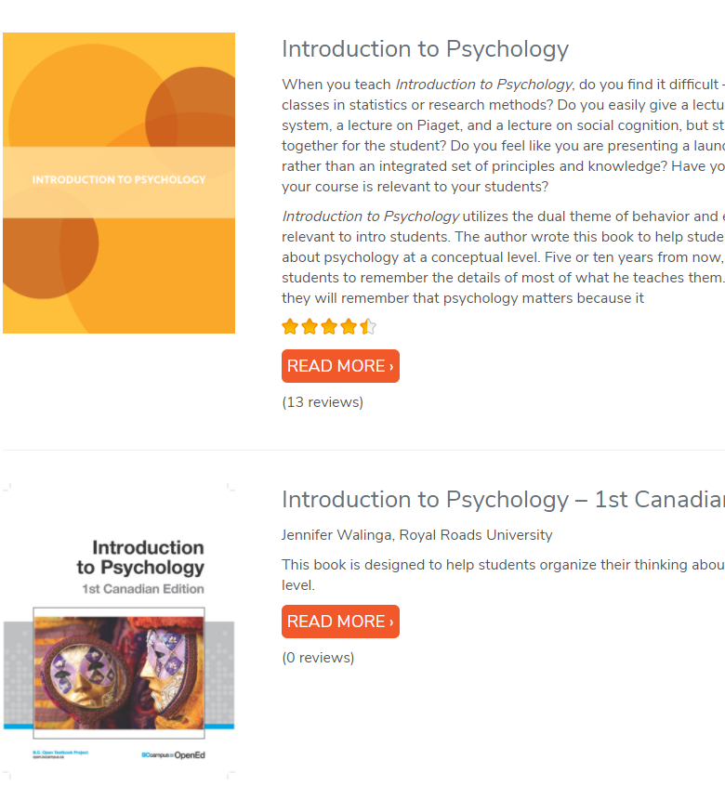
Finding OER: Starting Small
OpenStax: Introduction to Psychology textbook
Open Textbook Network: Social Sciences subject area

Slide 14
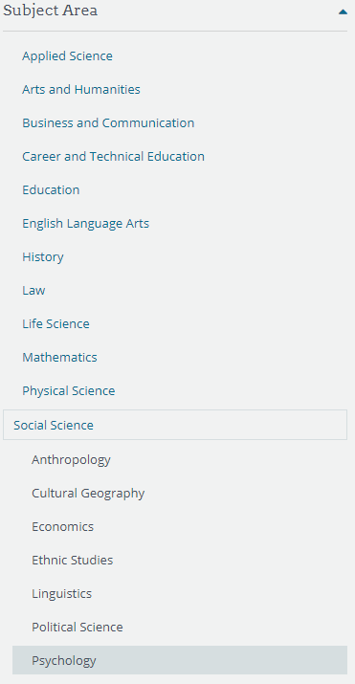
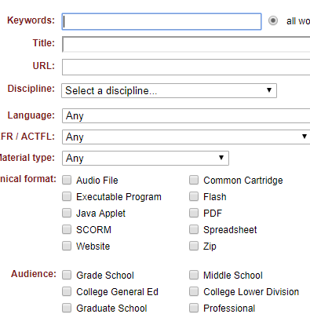
Finding OER: Ending Big
OER Commons: Search in Social Sciences, possibly for a subject within a chapter in an open textbook or NOBA module
  Narrow the results by facets
MERLOT: Advanced Material Search
  Material type, discipline, audience, format

Slide 15
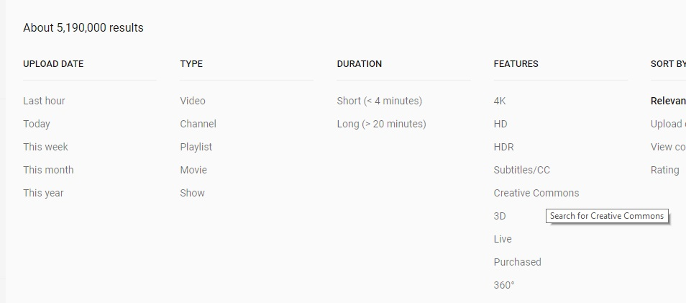
Finding OER in Unexpected Places
Search with Creative Commons filters!

Slide 16
Instructional Faculty…
Contribute by sharing their knowledge through OER and experiences in using OER through advocacy
Attribute all members of their own OER teams in a project
Release OER beyond the learning management system and enable sharing, remixing, revising
Empower all learners by inviting them into the creation process & keeping accessibility in mind when creating

Slide 17
Librarians…
Contribute their knowledge of copyright, open licensing, hosting, and discovery
Attribute by using proper metadata when sharing OER, teaching faculty to attribute correctly in course materials
Release OER with their knowledge of repositories and open course platforms (even LibGuides!)
Empower those new to OER through training and development, workshops, and consultations

Slide 18
Instructional Designers…
Contribute their knowledge of educational research, scaffolding, backwards design, etc. in the design of new OER and the evaluation of OER efficacy
Attribute all members of their own OER “village” in a project
Release OER to all learners in a manner equal to a LMS implementation
Empower all learners through their knowledge of accessibility and Universal Design for Learning (UDL)

Slide 19
ALG Textbook Transformation Grants:
(as of February 12, 2018)
To date, all ALG programs have saved students over $31 million on textbook costs
219,343 students have benefited
$19 million annual projected savings from current grants (up to Round Eleven)
Total grant awards so far: $3.35 million

Slide 20
Textbook Transformation Grants: The Basics
Three different sizes (standard, large, mini)
Supporting faculty time, travel, materials, additional support, etc.
Proposals submitted, peer-reviewed, awarded
Contract is with institution, not individual
All USG institutions have been awarded grants (347 applications, 175 funded projects)

Slide 21
Getting Started
Join the ALG Newsletter list. http://affordablelearninggeorgia.org/newsletters
Form a team of transformers.
(You want to make sure you’re impacting quite a few students with your project directly.)
Do an initial OER / library / Web review.
(Do you have some ideas? Examples? Do you need to reinvent the wheel or just revise and remix?)
Put together a plan.
Keep accessibility in mind (ADA compliance / S. 508).

Slide 22
When the new RFP is announced…
Read the RFP carefully.
Put the deadline and the Kickoff Meeting on your calendar.
Work with your team to apply.

Slide 23
Talk to your Campus Champion and Library Coordinator!
http://affordablelearninggeorgia.org/about/
champions_coordinators/
Library Coordinator: Virginia Feher
Virginia.Feher@ung.edu
Campus Champion: Bonnie (BJ) Robinson
BJ.Robinson@ung.edu

Slide 24
Thank you!
Contact me at jeff.gallant@usg.edu.

